Slide 1
Introduction
By: Dr. Ali Hamzeh

Slide 2
Session #1

Slide 3

Introduction
Introduction

Slide 4

What is Intelligent?
What is Intelligent?

Slide 5

What is Intelligence?
Intelligence can be defined as the capability of a system to adapt its behaviour to ever-changing environment.
Intelligence
Russell
Think Humanly
Act Humanly
Think Rationally
Act Rationally
How can we find that we act rationally?
Acting rationally leads to Minimize Error (close to zero)

Slide 6

Intelligent agent
What is Intelligent agent?

Slide 7

Intelligent agent
An intelligent agent (IA) is an autonomous entity which observes through sensors and acts upon an environment using actuators (i.e. it is an agent) and directs its activity towards achieving goals (i.e. it is rational
Intelligent agents may also learn or use knowledge to achieve their goals.
They may be very simple or very complex: a reflex machine such as a thermostat is an intelligent agent, as is a human being, as is a community of human beings working together towards a goal.

Slide 8

Artificial Intelligence
What is Artificial Intelligence?

Slide 9
What is Artificial intelligence?
In Artificial intelligence we will learn optimization approaches
Optimization approach
Optimization approaches are classified to two category :
Finding the min/max of the function
particular applications (k-means)
Inspired by nature
Human created

Slide 10

What is Artificial intelligence?
In Artificial intelligence we will learn:
Fuzzy Logic (FL)
Pattern Recognition
Evolutionary Computation (EC)
Neural Network (NN)
Machine Learning (ML)
Image processing
vision

Slide 11
Session #2

Slide 12
Bio inspired computing
Bio-inspired computing is the use of computers to model the living phenomena, and simultaneously the study of life to improve the usage of computers.
It is a field of study that often closely related to the field of artificial intelligence, as many of its pursuits can be linked to machine learning. It relies heavily on the fields of biology, computer science and mathematics.
Bio-inspired computing
Artificial Intelligence
EC
….
Biological computation
NN

Slide 13

What is Evolutionary Computation?
Evolutionary Computation :
The evolutionary approach is based on computational models of natural selection and genetics. We call them evolutionary computation

Slide 14
The Concept of Natural Selection
Limited number of resources
Competition results in struggle for existence
Success depends on fitness
fitness of an individual: how well-adapted an individual is to their environment. This is determined by their genes (blueprints for their physical and other characteristics).
Successful individuals are able to reproduce and pass on their genes
When changes occur ...
Previously “fit” (well-adapted) individuals will no longer be best-suited for their environment
Some members of the population will have genes that confer different characteristics than “the norm”. Some of these characteristics can make them more “fit” in the changing environment.

Slide 15
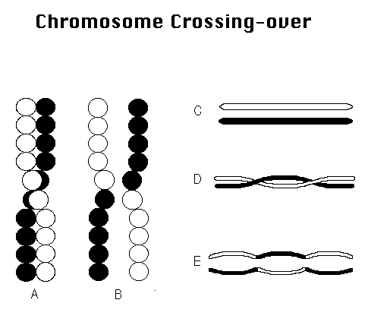
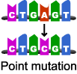
Major operators of Genetic Change in Individuals
X-over
selection
mutation

Slide 16
Evolution vs. adaptation
Evolution used to create optimization procedures or methodologies that are used to solve problems.
Evolution has optimized biological processes
Therefore , Adoption of the evolutionary paradigm to computation and other problems can help us to find optimal solutions.
Adaptation leads the individuals to adapt to its environment

Slide 17
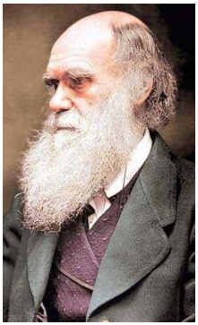
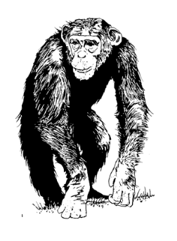
Religion beliefs and Darwinian theory
Darwinian evolution theory:
Darwin’s theory of evolution offers an explanation of the biological diversity and its underlying mechanism
given an environment that can host only a limited number of individuals and the basic instinct of individuals to reproduce, selection becomes inevitable if the population size is not to grow exponentially.

Slide 18

Human brain
Brain is the best solution finder in nature
Approaches that try to implement human brain are :
Neural Network (NN)
Evolutionary Computing (EC)
Evolutionary approaches utilize three main operator
Each approach use these three operator is classified as a bio-inspired approach
Strong optimizer
mutation
X-over
selection

Slide 19


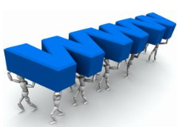
Why don’t we evolve?
X-over is stopped
The evolution of human beings is stopped while we stop these three main operators
selection is stopped
mutation is stopped

Slide 20
Session #3

Slide 21
4 main brands of evolutionary
Genetic Algorithm
GA
Evolutionary Strategy
ES
Evolutionary Programming
EP
Genetic Programming
GP

Slide 22

Evolutionary computing position
science
Exact science
Computer science
Computational intelligence
Evolutionary computing

Slide 23


Evolution v.s problem solving
Evolution
Problem solving
Environment
problem
individual
Candidate solution
fitness
Quality

Slide 24
Why use evolution as a model for solving computational problems?
Search space too big -- search won’t return within our lifetimes
The Nature of Computational Problems Require search through many possibilities to find a solution.
These types of problems are better solved using a parallel approach
Evolution Proves to be a Good Model for Solving these Types of Problems

Slide 25
Why use evolution as a model for solving computational problems?
Evolution is a parallel process
Evolution is in effect a method of searching for the best (optimal) solution from a great number of possibilities
Evolution can be seen as a method that designs new (original) solutions to a changing environment
Possibilities -- all individuals
Best solution -- the most “fit” or well-adapted individual
Testing and changing of numerous species and individuals occur at the same time (or, in parallel)

Slide 26
General Scheme of EAs
Parent selection
parents
initialization
Recombination
mutation
population
termination
offsprings
Survival selection

Slide 27
What are the different types of EAs
different flavours of EAs have been associated with different representations
Binary strings : Genetic Algorithms
Real-valued vectors : Evolution Strategies
Finite state Machines: Evolutionary Programming
LISP trees: Genetic Programming
GA
ES
EP
GP
What is the main difference between these 4 brands?
These differences are largely irrelevant, best strategy
- choose representation to suit problem
- choose variation operators to suit representation
Selection operators only use fitness and so are independent of representation

Slide 28

Representations
Candidate solutions (individuals) exist in phenotype space
They are encoded in chromosomes, which exist in genotype space
Encoding : phenotype=> genotype
Decoding : genotype=> phenotype
Chromosomes contain genes, which are in (usually fixed) positions called loci (sing. locus) and have a value (allele)
In order to find the global optimum, every feasible solution must be represented in genotype space

Slide 29

Representation
The first thing that should be determined in each type of evolutionary algorithm is “Representation” .
representation : In evolutionary algorithms the convert the phenotypic to genotypic

Slide 30

phenotype=> genotype
Why
phenotype=> genotype
is not necessarily be one to one?

Slide 31

Representation- what do you think?
Which one is preferred?
one to one mapping
phenotype=> genotype
OR
many to one mapping

Slide 32
Session #4

Slide 33

Evaluation (Fitness) Function
Represents the requirements that the population should adapt to
a.k.a. quality function or objective function
Assigns a single real-valued fitness to each phenotype which forms the basis for selection
So the more discrimination (different values) the better
Typically we talk about fitness being maximised
Some problems may be best posed as minimisation problems, but conversion is trivial

Slide 34


Population
Holds (representations of) possible solutions
Usually has a fixed size and is a multiset of genotypes
Some sophisticated EAs also assert a spatial structure on the population e.g., a grid.
the initialization of genotype in population is usually random
Selection operators usually take whole population into account i.e., reproductive probabilities are relative to current generation
Diversity of a population refers to the number of different fitnesses / phenotypes / genotypes present (note not the same thing)

Slide 35
Population
Phenotype diversity means the individuals of population are different
Genotype diversity means the DNA of individuals are different
Fitness diversity means the fitness of population be different

Slide 36
Population
Fitness diversity
Fitness diversity leads to have phenotype diversity
But the reverse is not true
Phenotype diversity
phenotype diversity leads to have Genotype diversity
But the reverse is not true
Genotype diversity
Genotype diversity
Phenotype diversity
Fitness diversity

Slide 37

Parent Selection Mechanism
Assigns variable probabilities of individuals acting as parents depending on their fitnesses
Usually probabilistic
high quality solutions more likely to become parents than low quality
but not guaranteed
even worst in current population usually has non-zero probability of becoming a parent
This stochastic nature can aid escape from local optima

Slide 38

Parent selection
Do you think is it good to give more chance to the parent that have proper fitness to
contribute on evolution stages?

Slide 39
Parent Selection- one max
1
1
1
1
1
1
0
Fitness 99%
1
1
1
1
0
0
0
Fitness 50%
1
1
1
1
1
1
1
X-over
0
0
0
0
0
0
1
Fitness 10%
In this example if the bad chromosome don’t have the chance to cooperate
on the evolution the final solution wont be find.
The only technique that can be helpful is mutation.
Hence we can apply parent selection to avoid trapping in local optima

Slide 40

Variation Operators
Role is to generate new candidate solutions
Usually divided into two types according to their arity (number of inputs):
There has been much debate about relative importance of recombination and mutation
- Nowadays most EAs use both
- Choice of particular variation operators is representation dependant
Arity =1 mutation operators
Arity >1 Recombination operators
Arity = 2 typically called crossover

Slide 41


Mutation
Acts on one genotype and delivers another
Element of randomness is essential and differentiates it from other unary heuristic operators
Importance ascribed depends on representation and dialect:
May guarantee connectedness of search space and hence convergence proofs
Binary GAs – background operator responsible for preserving and introducing diversity
EP for FSM’s/ continuous variables – only search operator
GP – hardly used

Slide 42

Recombination
Merges information from parents into offspring
Choice of what information to merge is stochastic
Most offspring may be worse, or the same as the parents
Hope is that some are better by combining elements of genotypes that lead to good traits
Principle has been used for millennia by breeders of plants and livestock

Slide 43
Mutation Vs. crossover
mutation
Cross over
Insert new genetic material
Combine the genetic material of the parents
The new born child have lower hamming distance with its parents since it change just one or two gens of chromosome
A random search operator
the lower genotypic distance leads to preserve the Continuity of the search space
The motivation of x-over is to find different part of the final solution and create a chromosome that can solve more part of the problem
Take long search steps in search space which leads to scape of the local optima and take fast convergence to the optimal point Out
Take short search steps in search space

Slide 44

Mutation Vs. crossover
GP
Crossover as the main variation operator
GA
Crossover as the main variation operator
ES
Mutation as the main variation operator

Slide 45

Survivor Selection
a.k.a. Replacement
Most EAs use fixed population size so need a way of going from (parents + offspring) to next generation
Often deterministic
Fitness based : e.g., rank parents+offspring and take best
Age based: make as many offspring as parents and delete all parents
Sometimes do combination (elitism)

Slide 46
Initialisation / Termination
Initialisation usually done at random
Need to ensure even spread and mixture of possible allele values
Can include existing solutions, or use problem-specific heuristics, to “seed” the population

Slide 47

Termination condition
Reaching some (known/hoped for) fitness
Reaching some maximum allowed number of generations
Reaching some minimum level of diversity
Reaching some specified number of generations without fitness improvement

Slide 48
Session #5

Slide 49
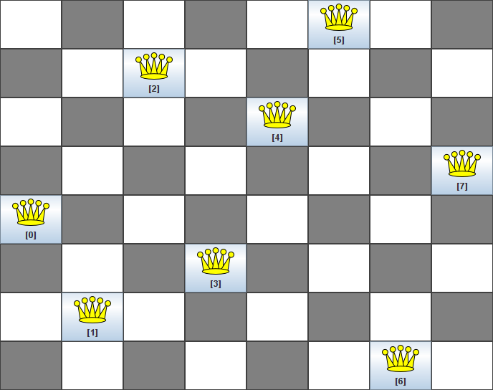
Example: the 8 queens problem

Slide 50

The 8 queens problem: representation
What is the representation of the 8 Queens problem ??

Slide 51
The 8 queens problem: representation
Phenotype:
a board configuration
Genotype:
a permutation of the numbers 1 - 8
Obvious mapping
1
3
5
2
6
4
7
8

Slide 52

8 Queens Problem: Fitness evaluation
Penalty of one queen:
the number of queens she can check.
Penalty of a configuration:
the sum of the penalties of all queens.
Note: penalty is to be minimized
Fitness of a configuration:
inverse penalty to be maximized

Slide 53
The 8 queens problem: Mutation
Small variation in one permutation, e.g.:
swapping values of two randomly chosen positions,
1
3
5
2
6
4
7
8
1
3
7
2
6
4
5
8

Slide 54
The 8 queens problem: Recombination
Combining two permutations into two new permutations:
choose random crossover point
copy first parts into children
create second part by inserting values from other parent:
in the order they appear there
beginning after crossover point
skipping values already in child
1
3
5
2
6
4
7
8
1
3
5
4
2
8
7
6
8
7
6
5
4
3
2
1
8
7
6
2
4
1
3
5

Slide 55
The 8 queens problem: Selection
Parent selection:
Pick 5 parents and take best two to undergo crossover
Survivor selection (replacement)
When inserting a new child into the population, choose an existing member to replace by:
sorting the whole population by decreasing fitness
enumerating this list from high to low
replacing the first with a fitness lower than the given child

Slide 56

Genetic Algorithm
Genetic
Algorithm

Slide 57
GA Quick Overview
Developed: USA in the 1970’s
Early names: J. Holland, K. DeJong, D. Goldberg
Typically applied to:
discrete optimization
Attributed features:
Special Features:
not too fast
good heuristic for combinatorial problems
Traditionally emphasizes combining information from good parents (crossover)
many variants, e.g., reproduction models, operators

Slide 58


Genetic algorithms
Holland’s original GA is now known as the simple genetic algorithm (SGA)
Other GAs use different:
Representations
Mutations
Crossovers
Selection mechanisms
selection
mutation
X-over
Representation
2002

Slide 59
Hints
GA (and its related category such as SGA) depend severely on the X-Over operator.
In the case that the X-Over operator become inactive, the performance of the
GA will decrease severely
Since the SGA is represented by 0-1 we should translate the phenotype
into binary genotype (0-1)
Some problems that we can solve them by 0-1 representation are:
1- classification
2-clustering
3-feature selection

Slide 60


SGA
Simple
GA`

Slide 61
SGA reproduction cycle
Select parents for the mating pool
(size of mating pool = population size)
Shuffle the mating pool
For each consecutive pair apply crossover with probability p_{c} , otherwise copy parents
For each offspring apply mutation (bit-flip with probability p_{m} independently for each bit)
Replace the whole population with the resulting offspring

Slide 62
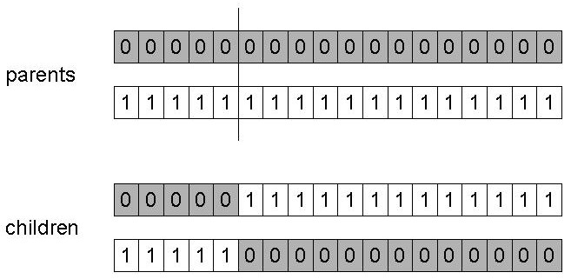
SGA operators: 1-point crossover
Choose a random point on the two parents
Split parents at this crossover point
Create children by exchanging tails
Pc typically in range (0.6, 0.9)

Slide 63
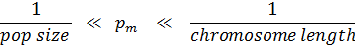
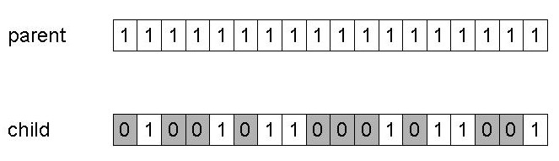
SGA Operators: Mutation
Alter each gene independently with a probability p_{m}
p_{m} the mutation rate :

Slide 64
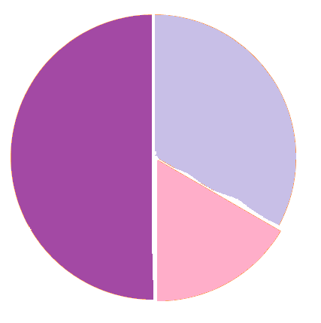

SGA operators: Selection
Main idea: better individuals get higher chance
Chances proportional to fitness
Implementation: roulette wheel technique
Assign to each individual a part of the roulette wheel
Spin the wheel n times to select n individuals
C
fitness(A) = 3
A
2/6 = 33%
fitness(B) = 1
3/6 = 50%
fitness(C) = 2
B
1/6 = 17%

Slide 65

An example after Goldberg ‘89 (1)
Simple problem: max x² over {0,1,…,31}
Representation
Population size
Cross over
1-point
mutation
bitwise
Selection
binary code, e.g. 01101 ↔ 13
4
Roulette wheel
Initialization
Random
GA approach

Slide 66
Solving the example
1- First we initialize a random population:
For example these numbers are generate randomly => (13, 24, 8, 19)
These numbers are in phenotype space, we should transfer them to genotype space
13-> 01101 8->01000
24->11000 19->10011
2- Then we should compute the fitness of these chromosomes by the f(x)= x² function
3- the probability of roulette wheel portions are then computed
4-for obtaining the Expected values we have to find E(x)=n × p(x). here n=4 so:
5-then Spin the roulette wheel and pick chromosomes
6-then apply the x-Over
Each chromosomes’ fitness
:
169
576
,
64
,
361
,
Total sum
1170
1170
1170
1170
4×
14
4 ×
49
4 ×
6
,
4 ×
31
,
,
100
100
100
100

Slide 67
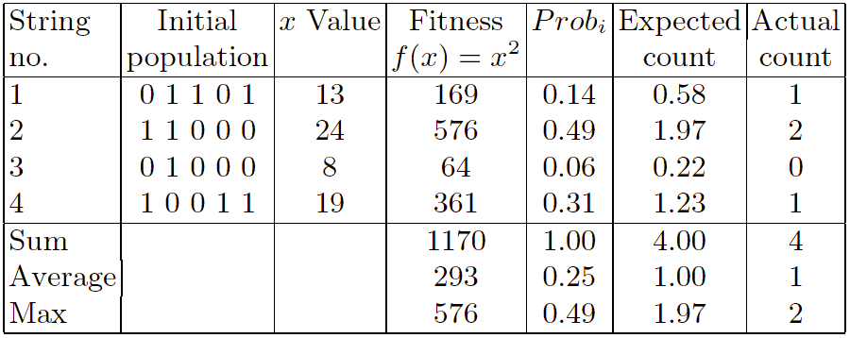
x² example: selection

Slide 68
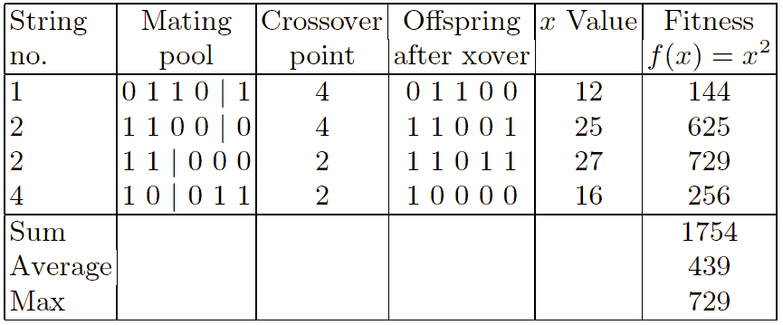
X² example: crossover
In this example we can see that the generated offspring of two good
parents will not always be better than them and in some cases it will be worst.
Here by applying the x-over operator the average of the fitness values changed from 293 to 439
X-over will not always lead to gain better results
Now we should apply the mutation

Slide 69
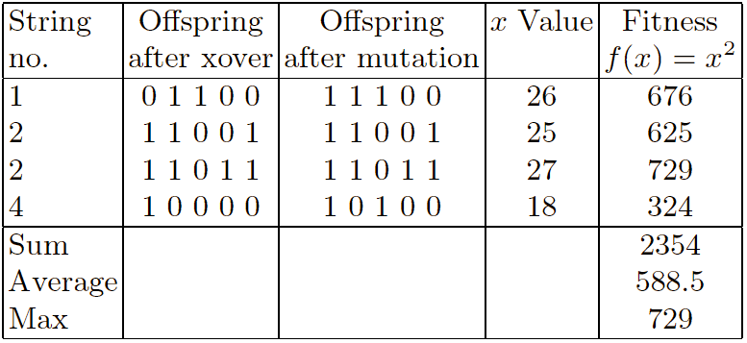
X² example: mutation
In this example we can see that the generated offspring of two good
parents will not always be better than them and in some cases it will be worst.
For this example the mutation is selected smartly but you know that
the mutation is a blind operator and sometimes may lead to destroy
the achievements.
In this example by applying the mutation operator the
maximum value is not changed but the average Is changed from 439 to 588.5

Slide 70

Representation of individuals
Depends on the problem
The most used encodings:
1
Real-valued representation
3
Integer representation
2
Binary representation
Permutations representation
4

Slide 71
Session #6

Slide 72

Binary Representations
simplest and most common
chromosome: string of bits
– genes: 0 / 1
Example: binary representation of an integer
3:
0
0
0
1
1
15:
0
1
1
1
1
16:
1
0
0
0
0
0

Slide 73

Binary encoding problem
Remember:
small changes in genotype should cause small changes in phenotype
Gray coding solves problem.

Slide 74
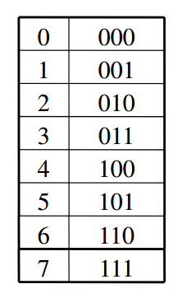
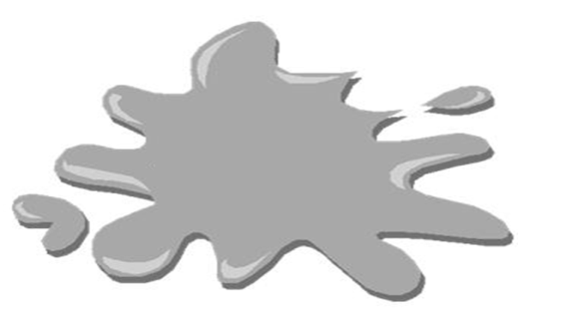
Gray coding
Binary coding of 0-7 :
• Hamming distance, e.g.:
– 000 (0) and 001 (1)
• Distance = 1 (optimal)
– 011 (3) and 100 (4)
• Distance = 3 (max possible)

Slide 75

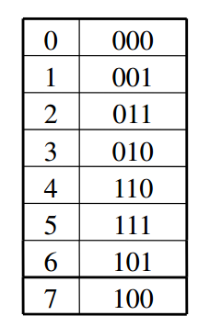
Gray coding
Gray coding
Gray coding of 0-7:
Gray coding is a representation that ensures that consecutive integers always have Hamming
distance one
Gray coding is a mapping that means that small changes in the genotype cause small changes in
the phenotype (unlike binary coding).

Slide 76

Good hints
Changes in genotype should provide the same amount of distance in phenotype
why??
Smoother” genotype-phenotype mapping is better for the GA

Slide 77

Permutation Representations
Ordering/sequencing problems form a special type
Task is (or can be solved by) arranging some objects in a certain order
Example: sort algorithm: important thing is which elements occur before others (order)
Example: Travelling Salesman Problem (TSP) : important thing is which elements occur next to each other (adjacency)
These problems are generally expressed as a permutation:
if there are n variables then the representation is as a list of n integers, each of which occurs exactly once

Slide 78



Permutation Representation
Two classes of problems
based on order of events
e.g. scheduling of jobs
– Job-Shop Scheduling Problem
based on adjacencies
e.g. Travelling Salesperson Problem (TSP)
– finding a complete tour of minimal length between n cities, visiting each city only once

Slide 79

Permutation Representation
Two ways to encode a permutation:
– i th element represents event that happens in that location in a sequence
– value of i th element denotes position in sequence in which i th event occurs
Example (TSP): 4 cities A,B,C,D and permutation [3,1, 2,4] denotes the tours:
– first encoding type: [C→A→ B→ D]
– second encoding type: [B→C→ A→ D]

Slide 80

Question
What is the different between np-hard and np-complete?
NP-hard (Non-deterministic Polynomial-time hard), in computational complexity theory, is a class of problems that it has never been proven that no polynomial-time solver is exist for NP-hard problems.
NP-complete (Non-deterministic Polynomial-time complete), in computational complexity theory, is a class of problems that it is proved that no polynomial-time solver is exist for solving these kind of problems.

Slide 81

Recombination
Recombination operator

Slide 82

Recombination
Two parents selected randomly
a random variable drawn from [0,1)
If value < pc
– two offspring created through recombination
Else
– two offspring created asexually (copy of parents)
Two parents selected randomly
a random variable drawn from [0,1)
value < pc
two offspring created through recombination
– two offspring created asexually (copy of parents)

Slide 83
X-over for binary rep.
Recombination for Binary Representation

Slide 84
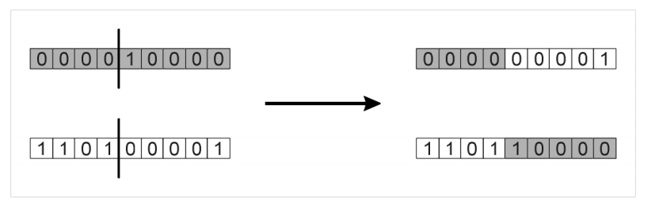
1 Point Crossover
Choose a random number in the range [0, l -1],
with l the length of the encoding
Split parents at this crossover point
Create children by exchanging tails

Slide 85

1 Point Crossover
Performance with 1 Point Crossover depends on the order that variables occur in the representation
1 Point Crossover
more likely to keep together genes that are near each other
Can never keep together genes from opposite ends of string
This is known as Positional Bias
Can be exploited if we know about the structure of our problem, but this is not usually the case

Slide 86

Positional bias
The main problem of cross-over in SGA is relate to positional bias
Example of a Positional bias :
if we have 2 proper parents and
The goodness of the first parent is regard to the first and last gene
The goodness of the second parent is regard to middle genes
By applying 1-point OR N-point cross-over the produced child can not contain the goodness of both parents
For the positional bias issue, We should define the representation in a way that
the fittest genes come beside each other .
since we don’t have enough knowledge about which combination of genes
are proper, this is a restrict point e.g. feature selection

Slide 87

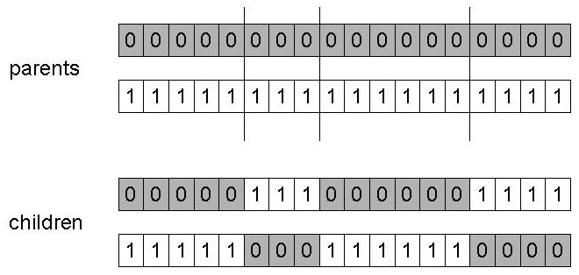
n-point crossover
Choose n random crossover points
Split along those points
Glue parts, alternating between parents
Generalisation of 1 point (still some positional bias)
This cross over has positional bias but in comparison with 1-point it is better.

Slide 88
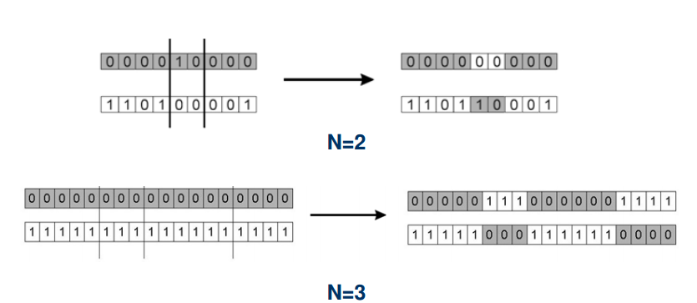
n-point crossover

Slide 89
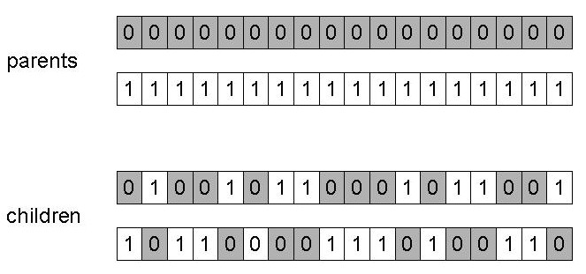
Uniform crossover
Assign 'heads' to one parent, 'tails' to the other
Flip a coin for each gene of the first child
Make an inverse copy of the gene for the second child
Inheritance is independent of position
This cross over has no positional bias

Slide 90
Positional & Distributional bias
Positional bias:
– e.g. in 1-point crossover bias against keeping bits at head and tail of string together
Distributional bias:
– in uniform crossover bias is towards transmitting – in uniform crossover bias is towards transmitting 50% of genes from each parent

Slide 91
Session #7

Slide 92
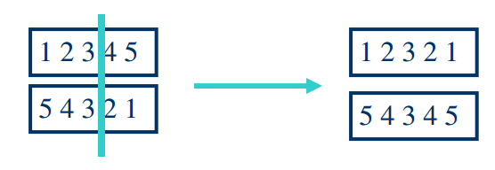
Recombination for Permutations Representation
Normal” crossover operators will often lead to inadmissible solutions
Many specialised operators have been devised which focus on combining order or adjacency information from the two parents

Slide 93

Recombination for Permutations Representation
Most commonly used operators:
For Adjacency-type Problems (e.g. TSP)
Partially Mapped Crossover (PMX)
Edge Crossover
For Order-type Problems (e.g. Job Shop For Order-type Problems (e.g. Job Shop Scheduling)
Order Crossover
Cycle Crossover

Slide 94
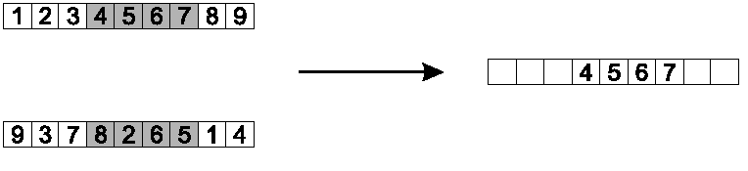

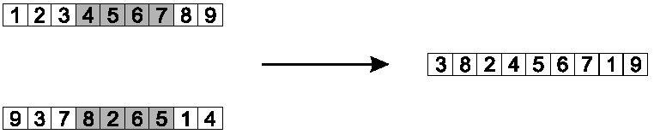
Order 1 crossover example
Copy randomly selected set from first parent
Copy rest from second parent in order 1,9,3,8,2

Slide 95
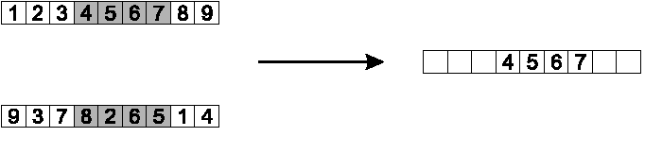
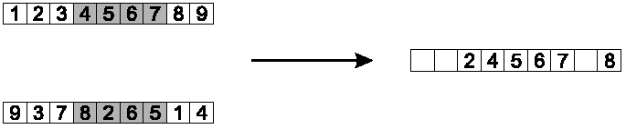
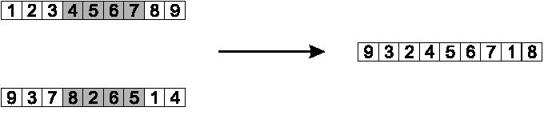
PMX example
Step 1
Step 2
Step 3

Slide 96
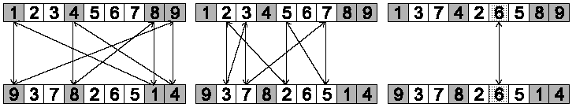
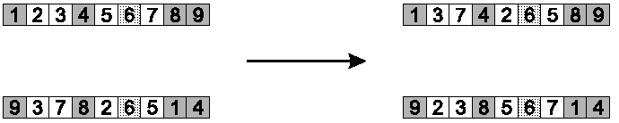

Cycle crossover example
Step 1: identify cycles
Step 2: copy alternate cycles into offspring

Slide 97
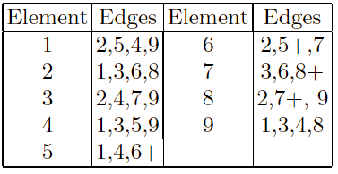

Edge Recombination
Works by constructing a table listing which edges are present in the two parents, if an edge is common to both, mark with a +
e.g. [1 2 3 4 5 6 7 8 9] and [9 3 7 8 2 6 5 1 4]

Slide 98

Cross over in details
Exploration
Exploitation
Optimising within a promising area, i.e. using information
Discovering promising areas in the search space, i.e. gaining information on the problem
There is co-operation AND competition between them

Slide 99
Exploration and Exploitation
1
Exploration: Order One>PMX>Cycle>Edge
2
Exploitation: Edge>Cycle>PMX>order one

Slide 100
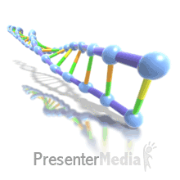
Mutation
Mutation is a variation operator
It is used to maintain genetic diversity from one generation of a population to the next
In mutation, the solution may change entirely from the previous solution
GA can come to better solution by using mutation
Occurs at a mutation rate: Pm
This probability should be set low
If it is set too high, the search will turn into a primitive random search

Slide 101

Bitwise Mutation
The mutation of bit strings ensue through bit flips at random positions.
setting of Pm depends on nature of problem,
typically between:
1/ pop_size
1 / chromosome_length
1
0
1
0
0
0
0
1
0
1
0
0
1
0
0
0
0
1

Slide 102

Flip Bit- mutation
This mutation operator takes the chosen genome and inverts the bits.
(i.e. if the genome bit is 1,it is changed to 0 and vice versa)
This mutation simply changes (flips) a randomly selected bit:
0
1
1
1
0
1
0
1
0
1
0
1
1
1
0
0
0
1
0
1
Implemented for binary genes only !

Slide 103

Boundary- mutation
This mutation operator replaces the genome with either lower or upper bound randomly.
This can be used for integer and float genes
.
upper
bound
7
2
1
3
0
7
4
7
2
1
3
0
1
4
OR
Lower
bound
7
2
1
3
0
0
4

Slide 104
Insert Mutation for permutations
Pick two allele values at random
Move the second to follow the first, shifting the rest along to accommodate
Note that this preserves most of the order and the adjacency information

Slide 105
Aspects of Insert Mutation
In order to investigate the capability of an operation on
exploration and exploitation, we should consider two parameter:
neighbor’s information
order
This mutation preserve : the order and the neighbor’s information
Preserved:
Destroyed:
neighbour’s information:
1-2
3-4
6-7
2-5 (since 2 is still before 5)
neighbour’s information:
3 and 4 regard to 5
Order:
The order of 3 and 4 is changed
The order of 5 is changed

Slide 106

Swap mutation for permutations
Pick two alleles at random and swap their positions
Preserves most of adjacency information (4 links broken), disrupts order more
This kind of mutation try to preserve the neighbors information
but it destroy the order
Destroyed:
Order:
The order of 2 is changed
The order of 3 and 4 are changed both regard to 3,4,5

Slide 107

Inversion mutation for permutations
Pick two alleles at random and then invert the substring between them.
Preserves most adjacency information (only breaks two links) but disruptive of order information

Slide 108

Scramble mutation for permutations
Pick a subset of genes at random
Randomly rearrange the alleles in those positions
(note subset does not have to be contiguous)

Slide 109
Crossover OR mutation?
Crossover OR mutation?

Slide 110

Crossover OR mutation?
Decade long debate: which one is better / necessary / main-background
Answer (at least, rather wide agreement):
It depends on the problem, but
In general, it is good to have both
Both have different role
Mutation-only-EA is possible, xover-only-EA would not work

Slide 111
Crossover OR mutation? (cont’d)
Crossover
It makes a big jump to an area somewhere “in between” two (parent) areas
Mutation
Mutation is exploitative
It creates random small diversions, thereby staying near (in the area of ) the parent
Crossover is explorative

Slide 112

Crossover OR mutation? (cont’d)
Only crossover can combine information from two parents
Only mutation can introduce new information (alleles)
Crossover does not change the allele frequencies of the population (thought experiment: 50% 0’s on first bit in the population, ?% after performing n crossovers)
To hit the optimum you often need a ‘lucky’ mutation

Slide 113
Cross over or mutation
If the cross over operator :
conserve the continuity of the search space and generate new gen
If the mutation operator :
Combine the information of parents and take large and small search steps and generate new gen
there is no need for cross over operator
there is no need for mutation operator

Slide 114

Cross over or mutation
Uniform and 1-point and n-point take large search space steps so
they can not conserve the continuality of search space and also they don’t
generate new gen so the mutation operator is necessary to be used.
So GA need both mutation and cross over operations

Slide 115
Session #9

Slide 116
PARENT
Multi
parent
Eiben, Agoston E., P-E. Raue, and Zs Ruttkay. "Genetic algorithms with multi-parent recombination." Parallel Problem Solving from Nature—PPSN III. Springer Berlin Heidelberg, 1994. 78-87.

Slide 117
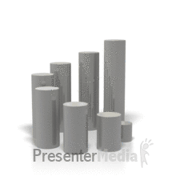
Multiple parents
Here we investigate genetic algorithms where more than two parents are involved in the recombination operation.
This time we introduce gene scanning as a reproduction mechanism with an arbitrary number (two or more) of parents.
gene scanning generalizes n-point or uniform crossover.
Motivation:
we try to find out whether multi-parent crossovers should be avoided for some practical reasons or whether they offer advantages and have just been overlooked.
one would expect that by biasing the recombination operator the performance of the GA would improve.

Slide 118

Multi-parent genetic operators
These operators use two or more parents to generate children.
The basic mechanism we use in order to define multi-parent operators is gene
scanning described below
The scanning techniques described in this chapter all generate one child from n parents (n ≥2)
scanning techniques
Uniform
Fitness based
Occurrence
based

Slide 119
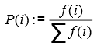

U-Scan & OB-Scan & FB-Scan
U-Scan
OB-Scan
FB-Scan
Each allele in the child is chosen by a uniform random mechanism
one child is created
Choosing from among the marked values is done by a majority function
chooses the value to inherit proportional to the fitness values of the parents.
If no value is in the majority the marked value in the first parent is chosen to be
inherited.
1
0
1
1
0
0
2
3
3
1
4
4
PARENT 1
PARENT 2
1
0
0
0
1
1
7
6
5
2
6
3
0
1
0
1
0
1
1
4
7
6
6
5
PARENT 3
0
1
0
1
0
1
PARENT 4
1
3
5
2
6
4
CHILD
1
0
0
1
0
1

Slide 120

four main issues
There were four main issues we were interested in:
Is scanning better than classical crossover?
Which version of scanning is superior to the other ones?
What is the optimal number of parents?

Slide 121
Parameter setting
Two 'real' problem :
1- TSP : use an instance concerning 30 cities
2- graph 3-coloring
Generational GA model
Representation: < an important factor in determining whether multi-parent recombination is
superior to two parent recombination >
TSP and graph coloring: order based representation
Number of parents: for n = 2,...,10
Having 100 or 200 runs
Crossover rate with 100% and mutation rate 50% (per individual, not per position)
Maximum number of generations=500

Slide 122
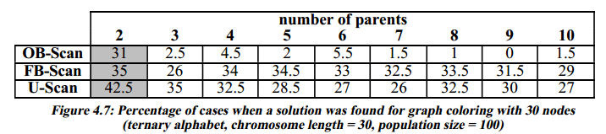
Graph coloring
We tested two graphs with 90 nodes and 5 edges per node.
This is known to be approximately the toughest topology for graph coloring
The results are shown below.
Representation: ternary alphabet , each symbol denoting one color
In this case we looked at the performance of the ‘standard’ scanning recombination mechanisms, given in the table below.

Slide 123
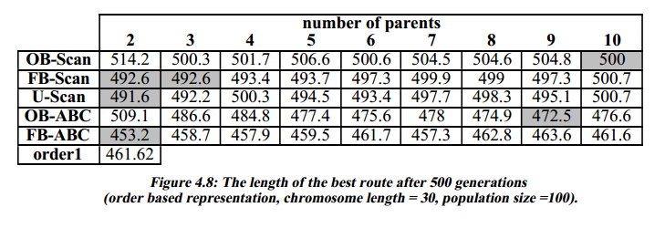
TSP
For TSP only OB-scanning and OB-ABC had an optimal number of parents above two, the other ones performed best with two parents.

Slide 124
Scanning and classical recombination
For TSP:
we compared different versions of scanning with order1 crossover
The FB-ABC (a multi-parent operator designed for TSP) turned out to be the best scanning mechanism, and was slightly (1.8%) better than order1
performance:
for the uniform, and FB-scaning was approximately the same,
OB-Scan was inferior to both
Adjacency:
FB-ABC clearly outperformed OB-ABC.
For graph coloring:
we found that choosing genes uniform randomly proved better than choosing FB-scan or OC-scan
..

Slide 125
The effect of different number of parents
The TSP shows a somewhat similar picture, means:
5 multi-parent recombination mechanisms was tested.
each of them has shown little variance in performance for different numbers of parents
For three of them the results became worse (by at most 2.3%) by increasing the number of parents above 2
for the two OB-scan mechanisms the optimal number of parents was 10, respectively 9, but the gain with respect to 2 parents did not exceed 7,2%
For graph coloring the data clearly shows that 2 parents are superior to higher numbers.

Slide 126
When is the optimal number of parents larger than 2?
Intuitively, using a greater number of parents, the child creation is biased on the basis of a larger sample from the search space.
In the case of a function which has many (almost) optimal points separated by 'gaps' of poor points, the sampling might not help.
The several good elements in a population may very well belong to the "gravity field" of different solutions.
Hence, the larger number of parents does not provide information about the same solution, and the generated child will most likely be somewhere in-between the (different) gravity fields of the parents, instead of getting closer to one of them.
Specifically, if there are relatively few (optimal) solutions, OB-Scan is expected to be the most effective, as in such a case the fit parents close to different solutions differ significantly (on many bits), and the occurrence-based inheritance of genes is likely to produce children close to that solution which is close to many of the parents.

Slide 127


Population Models
Population Models

Slide 128
Population Models
Population Models
Generational model
Steady state model

Slide 129

Generational Model
Population of individuals : size N
Mating pool (parents) : size N
Offspring
formed from parents
replace parents
are next generation : size N

Slide 130

Steady State Model
Not whole population replaced
N: population size (M < N)
– M individuals replaced by M offspring
Generational Gap
– percentage of the population that is replaced
– equal to M/N
M=1 & generational gap of 1/N has widely applied

Slide 131

Population Models
Each individual survives for exactly one generation
The entire set of parents is replaced by the offspring
SGA uses a Generational model
At the other end of the scale are Steady-State models:
Generation Gap
The proportion of the population replaced
1.0 for GGA, 1/popsize for SSGA
one offspring is generated per generation,
one member of population replaced,

Slide 132
Session #10

Slide 133
selection
selection

Slide 134
selection
Selection can occur in two places:
(parent selection)
Selection from current generation to take part in mating
(survivor selection)
Selection from parents + offspring to go into next generation

Slide 135

Implementation example: SGA
Expected number of copies of an individual i
E( n_{i} ) = μ • f(i)/ ⟨f⟩
Roulette wheel algorithm:
Given a probability distribution,
spin a 1-armed wheel
n times to make n selections
No guarantees on actual value of n_{i}
Baker’s SUS algorithm:
n evenly spaced arms on wheel and spin once
Guarantees floor(E( n_{i} ) ) ≤ n_{i} ≤ ceil(E( n_{i} ) )
μ = pop.size
f(i) = fitness of i
⟨f⟩= avg. fitness in pop.

Slide 136

Selection mechanism
Selection
Rank – Based Selection
Tournament Selection
Fitness-Proportionate Selection
Linear Ranking
Exponential
Ranking

Slide 137
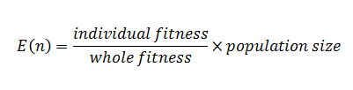
Fitness-Proportionate Selection
Expected value of an individual for being as a parent:
Two implementation
Roulete wheel
SUS
:

Slide 138
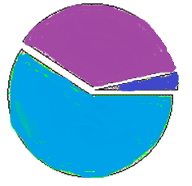
Fitness-Proportionate Selection
Roulete wheel
SUS

Slide 139
Implementation of RWF
Step1-
Chromosome 1 : fitness=4 P(A)=4/10
Chromosome 2 : fitness=5 P(B)=5/10
Chromosome 3 : fitness-=1 P(C) =1/10
Sum=10
Step2-
Chromosome 1
Chromosome 3
0
0.4
Chromosome 2
0.9
1
Generate a random number between [0-1] for example .75 and
then try to find its corresponding chromosome

Slide 140
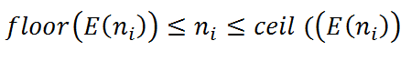
Implementation of SUS
Do not generate n random point
The distance between all indicators are for example 0.1
as we spin the roulete wheel one time we have for example:
.01+.1=.11
.11+.1=.21
.21+.1=.31
,…..
And in this way we have n random number with constant distances

Slide 141

Fitness-Proportionate Selection
Problems include:
One highly fit member can rapidly take over if rest of population is much less fit: Premature Convergence
At end of runs when fitnesses are similar, lose selection pressure
Highly susceptible to function transposition

Slide 142
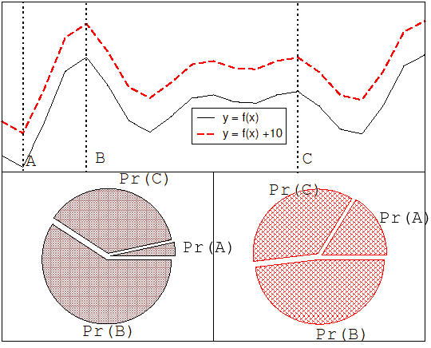
Function transposition for FPS

Slide 143
solution
Scaling
can fix last two problems
windowing
Sigma Scaling
f’(i) = f(i) - β ^{t}
f’(i) = max( f(i) – (⟨ f ⟩ - c • σ_{f} ), 0.0)
where β is worst fitness in this (last n) generations
where c is a constant, usually 2.0

Slide 144
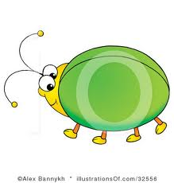
Function transposition for FPS
These two function are completely the same but one of them is the shifted version
of the other
If we use FPS the probability of each slice will gain by : <fitness(i)/total fitness>
Although the search of these two function is the same, the chromosomes’ portion are
different and so their result are different
one of the most highlighted problem of FPS is that it is sensitive to the function shift
the selection pressure is sensitive to the shift of the function

Slide 145

Rank – Based Selection
Rank – Based Selection

Slide 146



Rank – Based Selection
Attempt to remove problems of FPS by basing selection probabilities on relative rather than absolute fitness
Rank population according to fitness and then base selection probabilities on rank where fittest has rank μ and worst rank 1
This imposes a sorting overhead on the algorithm, but this is usually negligible compared to the fitness evaluation time

Slide 147
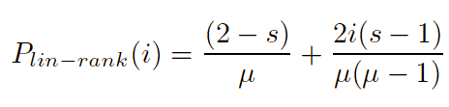

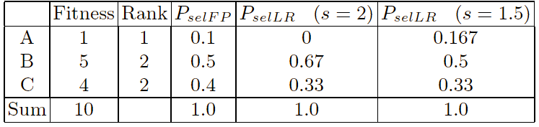
Linear Ranking
Control
parameter
Individual rank
Pop size
0<rank(i)<µ-1
Parameterised by factor s: 1.0 < s ≤ 2.0
measures advantage of best individual
in SGA this is the number of children allotted to it
Simple 3 member example

Slide 148
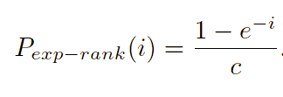
Exponential Ranking
Linear Ranking is limited to selection pressure
Exponential Ranking can allocate more than 2 copies to fittest individual
Normalise constant factor c according to population size

Slide 149

Problem of rank base
Sorting overhead is the main problem of rank based

Slide 150



Tournament Selection
Tournament Selection
Tournament Selection

Slide 151

Tournament Selection
All methods above rely on global population statistics
Could be a bottleneck esp. on parallel machines
Relies on presence of external fitness function which might not exist: e.g. evolving game players
Informal Procedure:
Pick k members at random then select the best of these
Repeat to select more individuals

Slide 152

Benefits of tournament selection
No need to sort the population
The closeness of fitness of population members have No effect
No sensitive to the shift of fitness function
The selection pressure is controlled by k
It can be implement in a parallel way
No need to have fitness function

Slide 153
Survivor Selection
Survivor Selection

Slide 154
Survivor Selection
Survivor Selection
Age-Based Selection
Fitness-Based Selection
* e.g. SGA
* In SSGA can implement as “delete-random” (not recommended) or as first-in-first-out (a.k.a. delete-oldest)
Using one of the methods

Slide 155
Elitism OR GENITOR: a.k.a. “delete-worst
Elitism
GENITOR: a.k.a. “delete-worst”
Widely used in both population models (GGA, SSGA)
From Whitley’s original Steady-State algorithm (he also used linear ranking for parent selection)
Always keep at least one copy of the fittest solution so far
Rapid takeover : use with large populations or “no duplicates” policy

Slide 156
Session #11

Slide 157

What Problems are HARD for GA?
What Problems are HARD for GA?

Slide 158
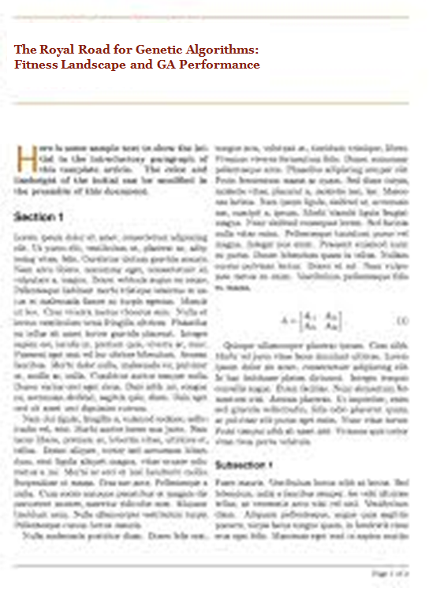
What Problems are HARD for GA?
The Royal Road for Genetic Algorithms: Fitness Landscape and GA Performance
Melanie Mitchell
Stephanie Forrest
John. H. Holland

Slide 159
What are principal GA theories?
principal GA theories
Schema Theory
Building Block Theory

Slide 160
Why Bother with Theory?
Might provide performance guarantees
Convergence to the global optimum can be guaranteed providing certain conditions hold
Might aid better algorithm design
Increased understanding can be gained about operator interplay etc.
Mathematical Models of EAs also inform theoretical biologists
Because you never know ….

Slide 161

Problems with Theory ?
EAs are vast, complex dynamical systems with many degrees of freedom
The type of problems for which they do well, are precisely those it is hard to model
The degree of randomness involved means
stochastic analysis techniques must be used
Results tend to describe average behaviour
After 100 years of work in theoretical biology, they are still using fairly crude models of very simple systems ….

Slide 162

Holland’s Schema Theorem
A schema (pl. schemata) is a string in a ternary alphabet ( 0,1 # = “don’t care”) representing a hyperplane within the solution space.
E.g.
This means all chromosomes that:
First bit=0 fifth and sixth bit is not important
Second bit=0 seventh bit=1
Third bit=0 eighth and ninth bit is not important
Fourth bit=1
E.g.
This means all chromosomes that:
the two first bits are not important
the third bit =1
the two following bit are not important
the sixth bit=0
the two following bit are not important
0001# #1# #0#
##1##0##

Slide 163

Holland’s Schema Theorem
Two values can be used to describe schemata,
the Order (number of defined positions) = 6,2
the Defining Length - length of sub-string between outmost defined positions = 9, 3
Order
Defining Length
schemata

Slide 164
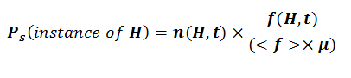
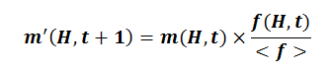
Schema Fitness
The true “fitness” of a schema H is taken by averaging over all possible values in the “don’t care” positions, but this is effectively sampled by the population, giving an estimated fitness f(H)
H
a schema
f(H)
Average fitness
n(H,t)
Number of members belong to a schema in iteration t
With Fitness Proportionate Selection
therefore proportion in next parent pool is:

Slide 165
Question
Which schemas have the Growth potential?
Have more potential to increase their members
In GA we are looking for the schema of solutions not the exact solution
but
The answer of this question is depend on other aspects in regard to evolutionary operators

Slide 166

Question
Suppose we apply 1-point cross over on parents. For this action one parent
selects from the current schema but the other one doesn’t. in what condition
their offspring belongs to the schema of the first parent ??
In the case that the cut point doesn’t
appear in defining length of that schema
1#000#0
defining length

Slide 167
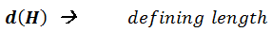
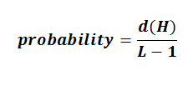
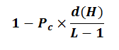
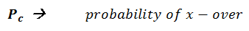
Schema Disruption II- xover
The probability that the cut point apear out of defining length in
1-point x-over:
The probability of survival with regard to x-over:

Slide 168
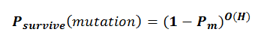

Schema Disruption II- mutation
The probability of survival with regard to mutation:
Which we extend it to:

Slide 169


The Schema Theorem
Put together, the proportion of a schema H in successive generations varies as:
Probability of survive with regard to x-over
Probability of survive with regard to mutation
Probability of survive with regard to selection
<f> : the average of fitness
f(H): the fitness of H in iteration t
m(H,t): the ratio of members that obey the schema H in iteration t

Slide 170

Question
Why we use the for this formula?
Since many break point cases will happen.
For example 2 parent which are not belong to
Current schema will have x-over and produce
An offspring which belong to that schema.
Or may be one chromosome is not belong to this
Schema but after a mutation that chromosome
become a member of that schema

Slide 171


Question
In what conditions schema increase its representation?
What ever the result of multiplying of the three terms
(selection*cross over*mutation) become a smaller number
,the growth of the optimal schema is slower.
what is the Increasing of schema’s representation depends on?
This is the weakness of selection that deeply depends on fitness
The ratio of

Slide 172

Implications 1: Operator Bias
One Point Crossover
less likely to disrupt schemata which have short defining lengths relative to their order, as it will tend to keep together adjacent genes
this is an example of Positional Bias
Uniform Crossover
No positional bias since choices independent
BUT is far more likely to pick 50% of the bits from each parent, less likely to pick (say) 90% from one
this is called Distributional Bias
Mutation
also shows Distributional Bias, but not Positional

Slide 173

Building Block Theory
Discovering new schemata via X-Over
Combining Partial Solutions
Building Block Theory

Slide 174
What are effective features?
Known effective fitness landscape’s features which can make a particular problem hard or easy for GA?
Deceptive Functions
Deception
Premature convergence
Sampling Error
Multi optimal landscape
Number of Local Optima

Slide 175

Deception and Walsh Transforms
Simple function of Unitation
Much analysis has concentrated on Walsh Transforms
Similar to Fourier transform in continuous domain
Natural link between schema and Walsh partitions
1.0
F(u)
0.6
0
2
1
0
4
3
u

Slide 176

Implications 2:The Building Block Hypothesis
Closely related to the Schema Theorem is the “Building Block Hypothesis” (Goldberg 1989)
This suggests that Genetic Algorithms work by discovering and exploiting “building blocks” - groups of closely interacting genes - and then successively combining these (via crossover) to produce successively larger building blocks until the problem is solved.
Has motivated study of Deceptive problems
Based on the notion that the lower order schemata within a partition lead the search in the opposite direction to the global optimum
i.e. for a k-bit partition there are dominant epistatic interactions of order k-1

Slide 177
Criticisms of the Schema Theorem
It presents an inequality that does not take into account the constructive effects of crossover and mutation
Exact versions have been derived
Have links to Price’s theorem in biology
Because the mean population fitness, and the estimated fitness of a schema will vary from generation to generation, it says nothing about gen. t+2 etc.
“Royal Road” problems constructed to be GA-easy based on schema theorem turned out to be better solved by random mutation hill-climbers
BUT it remains a useful conceptual tool and has historical importance

Slide 178
Session #12

Slide 179
Defining Test Functions to examine ST and BB theorems
Examine ST and BB theorems
Features which are more relevant to landscape
Test Function must be defined in terms of above criteria
Degree of hierarchy of landscape
Royal Road Function
Existing of intermediate solutions “stepping stones”
z
Degree of isolation of
fit schemas
S= {s₁,…,s_{n}}
where n=2^{l}

Slide 180

Sample of Royal Road Function
One-max problem
RR 64 with 4 level Schema
The fitness will count eight if eight “1” come beside each other.
Fitness will count 16 if->sixteen “1” come beside each other
Optimum fitness : 8*8 + 4*16 + 2*32 + 64 = 256

Slide 181
Why Royal Road is for GA?
Tree of increasingly higher-order schemas
Because of long hamming distance between different fitness levels, GA potentially can handle RR better than hill climbing family
X-over potentially can find higher-order schemas quickly from lower-order ones
RR Characteristics

Slide 182

Different versions of RR
3)Introduce Gaps Harder, because of waiting time for build Schemas
2)Modify Steepness
1)Modify Levels harder because of waiting time for appearing schemas
Different Variations of RR

Slide 183
Results of applying GA on RR
Hill climbing fails
X-Over improves performance significantly
X-Over reduces waiting time for discovery process
Discovery gaps are too long
 | Mean gens to optimum | Median gens to optimum
GA with X-over | 590(50) | 542
GA ,No X-over | 1022(46) | 1000
Hill climbing | >2000 | >2000
 | Order 8 | Order 16 | Order 32 | order64
GA with X-over | .01(.1) | 28(4) | 152(16) | 590(50)
GA ,No X-over | .3(.25) | 106(14) | 386(26) | 1022(46)

Slide 184
Important Points
x-over is effective on GA
why GA could reached to a solution without applying the x-over operator while Hill climbing didn’t?
GA without x-over will work with its mutation operator
In hill climbing, each point explore its surrounding points with a small distances till find a better point
in other word, here mutation is act the same as hill climbing
in GA the mutation rate is less than hill climbing
GA is a parallel hill climber (means run hill climbing 50 times)

Slide 185
Important Points
 | Order 8 | Order 16 | Order 32 | order64
GA with X-over | .01(.1) | 28(4) | 152(16) | 590(50)
GA ,No X-over | .3(.25) | 106(14) | 386(26) | 1022(46)
With x-over: .01
When octet schema are formed
Without x-over: .3
Both are in the same range and no significant difference is seen
This means that the octet schema are present in the population with or without x-over
With x-over: 28
When hexane schema are formed
Without x-over: 106
this means 28 or 106 generation is left till this scheme is obtained

Slide 186
Important Points
With x-over: 152
152-28=130 generation
When 32(??) schema are formed
Without x-over: 386
386-106=250 generation
….
Whatever the order is increased the performance of the algorithm will be unchange
And it seems something is happen in GA
Why x-over in Royal Road
is disabled????

Slide 187



What is Unexpected?
Long steps between discovery of 16-order schema and 32-order schema?
BB theorem said that this task must be done very quickly
Why?
Measurement method may be incorrect?
Simultaneously Appearance
Appearing and disappearance

Slide 188
Experiment about Intermediate Levels
Eliminating level 16 and 32 from original RR
Solving this problem must be harder than original RR for GA
Why?
Results are Surprising
 | Mean gens to optimum | Median gens to optimum
Intermediate levels | 590(50) | 542
No intermediate levels | 427(34) | 372
Hill climbing No intermediate levels | >2000 | >2000

Slide 189

Experiment about Intermediate Levels
The solution of this problem is in “intermediate level”
With introducing the “intermediate level” we destroy the parallelism of GA
GA=Parallel Problem Solver
GA try to merge different part of the problem and find the solution
We dictate the GA how to merge Building Blocks and didn’t permit the algorithm
To arrange these Building Blocks by itself in a parallel way

Slide 190
Experiment about Intermediate Levels
 | Mean gens to optimum | Median gens to optimum
Intermediate levels | 590(50) | 542
No intermediate levels | 427(34) | 372
Hill climbing No intermediate levels | >2000 | >2000
When we get the reward for merging two Building Blocks
The algorithm should perform better
The Holland expected that by omitting the intermediate the problem will be hard
But the improvement was achieved.
unexpected

Slide 191
Experiment about Intermediate Levels
GA should know how to solve the problem
GA by itself should merge the building blocks
during determining the fitness function we shouldn't decide about the way of solving
Royal Road decide a bout this way by its definition of fitness function
Whatever more domain knowledge involve with system the performance of GA will
fall down
GA is inspired from nature and the nature doesn’t monitor the search nevertheless
The nature search is random

Slide 192
WHY?
Long distance between fitness of order 8 and order 16 schemas
1
1
1
*
*
*
…
*
Vs
1
1
1
1
1
1
*
*
*
…
*
8
Vs
32
Premature Convergence
Without intermediate levels, GA can jump this hole
1
1
1
*
*
*
…
*
Vs
1
1
1
1
1
1
*
*
*
…
*
8
Vs
16
=> Parallelism in GA

Slide 193

What makes a problem hard for a genetic algorithm?
What makes a problem hard for a genetic algorithm? Some anomalous results and their explanation
Stephanie Forrest
Melanie Mitchell

Slide 194
When we can use GA?
The space is not well-understood
Special purpose algorithm is not found
A suitable GA representation can be developed
GA can astonish us
BUT GA Convergence Property
Can cause premature convergence with small sampling error

Slide 195


Partition Concept
Partition number 0 (A)
Partition number 1 (B)
Partition number 2 (C)
Partition number 3 (D)

Slide 196


Walsh Functions
To define some functions which are highly related to schema concept in GA

Slide 197
GA and Walsh Transform
1
It makes progressively deeper estimates of what F’s Walsh coefficients are
2
biases the search towards partitions j with high-magnitude w_{i} and to the partition elements (schemas) for which these correction terms are positive.
GA can be described via Walsh transform:
u(s) is the average value of fitness of all chromosomes belong to schema s (fitness function has been transformed under Walsh transformation)
u(s) only depends on the terms which j subsumes s.
u
GA can be described via Walsh transform:
u

Slide 198
What is Walsh Transform Really for?
Many fitness functions could not be transformed under Walsh transform easily even through “Fast Walsh Transform”
Some functions are defined in Walsh form from scratch
They can be used as useful tools let us theoretically analyze the behavior of GA deeply.
They can be provide us an artificial fitness functions which can be deceptive, based on BB theorem or with any desired features
One of these test beds is Tanese Functions

Slide 199
Tanese function
A Walsh function with these properties
All of the non-zero terms are of the same order
(originally even order)
There exists a global optimum x’ whose fitness receives a positive contribution from all terms.

Slide 200

Tanese Functions’ Properties
These functions are:
1
Easy to construct
2
Low-ordered function are easier than higher-order ones.
3
Global optimum is known

Slide 201
Experiment-Parameter setting
Chromosome length : 32 Bits
Population size is : 256
Sigma Scaling Method is employed
Expected number of offspring:
Mutation and crossover probabilities are per bit.
Order 8 Tanese Functions are used
64 of them are generated randomly
GA is compared with Iterated Hill Climbing

Slide 202
Session #13

Slide 203
Poor GA Performance
 | Time optimum found | Average max fitness | Average generation of max fitness | Average max mean fitness (% opt.)
Original | 0 | 88.1 (2.9) | 31(33) | 85.1(3.8)
No xover 32 | 0 | 88.4(2.7) | 22(28) | 86.2(2.6)
Def len 10 | 0 | 92.3(2.9) | 41(48) | 89.2(3.0)
Str-len 128 | 19 | 99.97(0.13) | 150(30) | 93.6(1.3)
No xover 128 | 17 | 99.85(0.45) | 72(41) | 93.9(0.6)
Hill 32 | 0 | 95.4(1.5) | - | -
Hill 128 | 20 | 100.0 (0.0) | - | -
GA Never reach optima.
Hill climbing outperforms GA

Slide 204
Possible Reasons for Poor GA Performance
Four possible reasons are proposed to explain poor GA performance (Note that two of them relates to crossover)
Chosen Performance Criteria
Lack of low order building blocks (inefficient crossover)
Long average schema length (disruptive crossover)
Large hidden schema order

Slide 205

Chosen Performance Criterion
Compare GA and IHC via on-line, off-line performance
What are Online and offline performances?
What do they show us?

Slide 206
Why is cross over not effective?
 | Time optimum found | Average max fitness | Average generation of max fitness | Average max mean fitness (% opt.)
Original | 0 | 88.1 (2.9) | 31(33) | 85.1(3.8)
No xover 32 | 0 | 88.4(2.7) | 22(28) | 86.2(2.6)
An order n Tanese function only can be described with schemas higher ordered than n.
Sample: 1110+1011+0111
S: 11**

Slide 207

Does defining length is effective?
 | Time optimum found | Average max fitness | Average generation of max fitness | Average max mean fitness (% opt.)
Original | 0 | 88.1 (2.9) | 31(33) | 85.1(3.8)
No xover 32 | 0 | 88.4(2.7) | 22(28) | 86.2(2.6)
Def-len 10 | 0 | 92.3(2.9) | 41(48) | 89.2(3.0)
Why Defining Length is important?
A main role of crossover
Is it really effective?
26 vs. 10

Slide 208
What is the Real Order of a particular Function?
0011+0110
Real Order : 3, Given Order: 2
 | Time optimum found | Average max fitness | Average generation of max fitness | Average max mean fitness (% opt.)
Original | 0 | 88.1 (2.9) | 31(33) | 85.1(3.8)
No xover 32 | 0 | 88.4(2.7) | 22(28) | 86.2(2.6)
Def len 10 | 0 | 92.3(2.9) | 41(48) | 89.2(3.0)
Str-len 128 | 19 | 99.97(0.13) | 150(30) | 93.6(1.3)
No xover 128 | 17 | 99.85(0.45) | 72(41) | 93.9(0.6)

Slide 209



GA Performance in Tanese Functions
Diversity Fails → Local Optima

Slide 210



GA Performance on Artificially Controlled Tanase Functions

Slide 211
Why does PGA perform better than GA
Mutation is more effective in smaller populations than larger ones. Because mutation can decrease chance of replication for fitter chromosomes.
Fit mutations in smaller populations are less likely to be destroyed by crossover
Converge to different Local Optima so their combination perform better
3
Tanese suggested that
2
1
1 is correct but 2 and 3 are probably wrong

Slide 212
Deception and Tanese Functions
What is Deception in GA?
1
Problem is Deceptive if Winner of a partition has different bit string than global optima,
2
A Problem is N-Ordered Fully Deceptive if in a N-order partition P, if the winner of all subsuming schemas lead to different than the partition contains winner of P
3
A Problem is N-Ordered Consistently Deceptive if in a N-order partition P, if the winner of some subsuming schemas lead to different than the partition contains winner of P.
Representation or Problem?

Slide 213

Deception and Tanese Functions
Consider P=dddd*
One of Winners is: 1111*
But the global optimum is : 10100, 01100
Tanese Function can be designed in a deceptive way

Slide 214

Theorem about Tanese Functions Relevant to Deception
Let P be any partition of the search space defined by Tanese function F. Then there exists a schema s in P such that s is a winner in P and for any P’ subsumed by P, there exist a winning schema s’ such that s’ is subset of s.
Is Tanese function Deceptive (GA-Hard) or GA-Easy
(Wilson claimed that such a function is GA-Easy)
IS DEFENITION OF DECEPTION AND COUNTING ON IT AS A HARDNESS MEASURE IS CORRECT?

Slide 215
Theorem about Tanese Functions Relevant to Deception
Overlap
Lower ordered Schemas’ Role
Long Schema Length
Deception

Slide 216
Fitness distance correlation as a measure of problem difficulty for genetic algorithms
Fitness distance correlation as a measure of problem difficulty for genetic algorithms
Terry Jones
Stephanie Forrest
All figures and some statements in slides 43-41 are directly drawn from [3].

Slide 217

GA as a Heuristic search Technique
GA is Similar to Heuristic Search Algorithms
Fitness Function as Heuristic Functions
In Heuristic Search Algorithms, Value Function is an estimation of Distance to Goal
So, Fitness Function also must do the same.
If r supposed to be correlation factor
r=-1 for maximizing functions and r=1 for minimizing ones

Slide 218

Operator detailed analysis
A Comparison of Selection Schemes used in Genetic Algorithms
Melanie Mitchell
Stephanie Forrest
John. H. Holland

Slide 219

A Comparison of Selection Schemes used in Genetic Algorithms
Genetic Algorithms(GA):
a probabilistic search algorithms characterized by the fact that a number N
of potential solutions (called individuals where represents the space
of all possible individuals) of the optimization problem simultaneously sample
the search space.
Population:
If J be a set of potential chromosomes then J^N means J*J*…*J
We extract N instances from this set.
So one instance from J^N construct the population

Slide 220


Fitness distribution (S function)
Fitness distribution:
The function assigns to each fitness value the number of individuals in a population
means
S>=0
The S function indicate that how many individuals are in the population which
have specified fitness
We can describe the population with S function

Slide 221

Selection method
Selection method:
A selection method is a function that transforms a fitness distribution s
in to a new fitness distribution :
All population can be described by S.
Before applying the selection operator The population is determined by S.
After applying the selection operator The population is determined by
Selection is also construct a population: input(population) output(population)
Function : input(fitness distribution) output(fitness distribution)

Slide 222


Expected fitness distribution
Expected fitness distribution:
denotes the expected fitness distribution after applying the selection method to the fitness distribution S , i.e.
The selection operators are stochastic .
The notation will be used as abbreviation.

Slide 223

Theorem 1
The variance in obtaining the fitness distribution S’ is

Slide 224


Prove Theorem 1
Prove :
: Denotes the expected number of individuals with fitness value after selection
It is obtained by doing experiments ”select an individual from the population using a certain selection mechanism".
Hence the selection probability of an individual with fitness value is given by
To each fitness value there exists a Bernoulli trial “an individual with fitness is selected“
As the variance of a Bernoulli trial with N trials is given by
And is obtained using

Slide 225


Cumulative fitness distribution
Cumulative fitness distribution:
Let n be the number of unique fitness values and
The ordering of the fitness values with denoting the worst fitness occurring in the population and denoting the best fitness in the population.
Denotes the number of individuals with fitness value or worse and is
Called cumulative fitness distribution.

Slide 226



Average Fitness
Average fitness:
Denotes the average fitness of the population before selection and
denotes the expected average fitness after selection:

Slide 227

Fitness Variance
Fitness Variance:
The fitness variance denotes the variance of the fitness distribution before selection and denotes the variance of the fitness distribution after selection:

Slide 228



Fitness Variance

Slide 229

Reproduction Rate
Reproduction Rate:
The reproduction rate denotes the ratio of the number of individuals with a certain fitness value after and before selection
A reasonable selection method should favor good individuals by assigning
Them a reproduction rate and punish bad individuals by a ratio

Slide 230

Loss of Diversity
Loss of Diversity:
The loss of diversity Pd is the proportion of individuals of a population that is not selected during the selection phase
Theorem: If the reproduction rate increases monotonously in f, the Loss of diversity of a selection method is:
Where fz denotes the fitness value such that
So R increase monotonously
Reproduction rate

Slide 231


Selection Intensity
Selection intensity:
The selection intensity of a selection method Ω for thefitness distribution is the standardized quantity
I
High selection pressure
I
low selection pressure

Slide 232



Selection Intensity
The selection intensity depends on the fitness distribution of the initial population.
Different fitness distributions will in general lead to different selection intensities for the same selection method.
For comparison it is necessary to restrict one self to a certain initial distribution.
Using the normalized Gaussian distribution as initial fitness distribution leads to
Mean
Mean
low variance
High variance

Slide 233




Standardized selection intensity
The standardized selection intensity is the expected averagefitness value of the population after applying the selection method Ω to the normalized Gaussian distribution
=0
I=
=1

Slide 234


Selection Variance
The selection variance is the normalized expected variance of thefitness distribution of the population after applying the selection method Ω to the fitness distribution
Variance after selection < variance before selection
high
Selection pressure is low
Selection variance
low
Selection pressure is high

Slide 235




Standardized selection variance
The standardized selection variance is the normalized expected variance of the fitness distribution of the population after applying the selection method Ω to the normalized Gaussian distribution
=0
V=
=1
Variance after selection
2
S
M

Slide 236
Session #14

Slide 237

Tournament Selection
Tournament Selection

Slide 238


tournament selection
Theorem 3.0.1:
The expected fitness distribution after performing tournament selection
with tournament size t on the distribution s is
t-> tournament size
-> the members that the amount of their fitness are more than fi
-> the probability of selecting t individual which their fitness are less than fi

Slide 239




Proof
We first calculate the expected number of individuals with fitness fi or worse ( )
An individual with fitness fi or worse can only win the tournament if all other individuals in the tournament have a fitness of fi or worse. This means we have to calculate the probability that all t individuals have a fitness of fi or worse. As the probability to choose an individual with fitness fi or worse is given by we get:
Using this equation and the relation we obtain
Shows the strong influence of the tournament size t on the behavior of the selection scheme. Obviously for t=1 we obtain(in average) the unchanged initial distribution as

Slide 240


Continuous fitness distribution
Theorem 3.0.2:
Let be the continuous fitness distribution of the population.
Then the expected fitness distribution after performing tournament selection with tournament size t is
In this equation
the number of members which
their fitness are become fi after tournament selection
depend on what conditions?
Tournoment size
The number of individual’s fitness itself
The number of individuals that have lower fitness

Slide 241


Concatenation of Tournament Selection
Assume an arbitrary population with the fitness distribution
We apply first tournament selection with tournament size t1 to this population and then on the resulting population tournament selection with tournament size t2.
The obtained fitness distribution is the same as if only one tournament selection with the tournament size t1 t2 is applied to the initial distribution
Theorem 3.1.1
Let be a continuous fitness distribution and two Tournament sizes. Then the following equation holds

Slide 242


Proof

Slide 243


Reproduction Rate
The reproduction rate of tournament selection is:
The size of the tournament determine the reproduction rate
The reproduction rate doesn’t depend on the number of individuals.

Slide 244




Loss of Diversity
Theorem3.3.1:
The loss of diversity of tournament selection is:
Proof:

Slide 245



Selection Intensity
To calculate the selection intensity we calculate the average fittness of the population after applying tournament selection on the normalized Gaussian distribution G(0,1)
Tournament size=1
Tournament size=2
Tournament size=3

Slide 246





Selection Intensity

Slide 247


Selection Variance
To determine the selection variance we need to solve the equation

Slide 248
4 main brands of evolutionary
Genetic Algorithm
GA
Evolutionary Strategy
ES
Evolutionary Programming
EP
Genetic Programming
GP

Slide 249
Session #15

Slide 250
Evolution strategies
Evolution
strategies

Slide 251

ES quick overview
ES Typically applied to numerical optimisation
Special:
self-adaptation of (mutation) parameters standard
Attributed features:
Fast
Good optimizer for real-valued optimisation
Relatively much theory

Slide 252
ES technical summary tableau
Representation | Real-valued vectors
Recombination | Discrete or intermediary
Mutation | Gaussian perturbation
Parent selection | Uniform random
Survivor selection | (μ,λ) or (μ+λ)
Specialty | Self-adaptation of mutation step sizes

Slide 253
Introductory example: mutation mechanism
z values drawn from normal distribution N(ξ,σ)
mean ξ is set to 0
variation σ is called mutation step size
σ is varied on the fly by the “1/5 success rule”:
This rule resets σ after every k iterations by
σ = σ / c if p_{s} > 1/5
σ = σ • c if p_{s} < 1/5
σ = σ if p_{s} = 1/5
where p_{s} is the % of successful mutations, 0.8 ≤ c ≤ 1

Slide 254
The concept of 1/5 success rule
This rule will apply after each k iteration and will change the value of δ
This calls adaptation :
(the algorithm tune its parameters by itself with respect to the knowledge that we insert to it)
If ps>1/5: if the percentage of fittest children is more than 1/5
then the algorithm raise the δ to increase the exploration
If ps>1/5: if the percentage of fittest children is equal to 1/5
then the algorithm will not change the δ
If ps<1/5: if the percentage of fittest children is less than 1/5
then the algorithm reduce the δ to increase the exploition

Slide 255


Illustration of normal distribution Genetic operators: mutations
The one dimensional case

Slide 256

Representation
Object variables: x₁,…,x_{n}
Mutation step sizes: σ₁,…,σ_{nσ}
Rotation angles: α₁,…, α_{nα}
Chromosomes consist of three parts:
Strategy parameters
Not every component is always present
Full size: ⟨ x1,…,xn, σ1,…,σn ,α1,…, αk ⟩
where k = n(n-1)/2 (no. of i,j pairs)

Slide 257
Mutation
Main mechanism:
changing value by adding random noise drawn from normal distribution
x’_{i} = x_{i} + N(0,σ)
Key idea
σ is part of the chromosome
⟨ x₁,…,x_{n}, σ ⟩
σ is also mutated into σ’
(see later how)
Thus: mutation step size σ is coevolving with the solution x

Slide 258

Mutate σ first
Net mutation effect: ⟨ x, σ ⟩ → ⟨ x’, σ’ ⟩
Order is important:
first σ → σ’ (see later how)
then x → x’ = x + N(0,σ’)
Rationale: new ⟨ x’ ,σ’ ⟩ is evaluated twice
Primary: x’ is good if f(x’) is good
Secondary: σ’ is good if the x’ it created is good
Reversing mutation order this would not work

Slide 259

Question
Why should we mutate δ first?
In other case the δ will not evolve.
Mutate δ last leads random search

Slide 260


Mutation case 1: Uncorrelated mutation with one σ
σ’ = σ • exp(τ • N(0,1))
Chromosome
1)
⟨ x₁,…,x_{n}, σ ⟩
2)
x’_{i} = x_{i} + σ’ • N(0,1)
Typically the “learning rate” τ ∝ 1/ n^{½}
And we have a boundary rule σ’ < ε₀ ⇒ σ’ = ε₀
Mutants with equal likelihood
Circle: mutants having the same chance to be created

Slide 261


Mutation case 2: Uncorrelated mutation with n σ’s
Chromosomes:
1) σ’_{i} = σ_{i} • exp(τ’ • N(0,1) + τ • N_{i} (0,1))
_{⟨ x1,…,xn, σ1,…, σn ⟩}
2) x’_{i} = x_{i} + σ’_{i} • N_{i} (0,1)
Two learning rate parmeters:
τ’ overall learning rate
τ coordinate wise learning rate
τ ∝ 1/(2 n)^{½} and τ’ ∝ 1/(2 n^{½}) ^{½}
And σ_{i}’ < ε₀ ⇒ σ_{i}’ = ε₀
Mutants with equal likelihood
Ellipse: mutants having the same chance to be created

Slide 262


Mutation case 3: Correlated mutations
Chromosomes:
σ’_{i} = σ_{i} • exp(τ’ • N(0,1) + τ • N_{i} (0,1))
where k = n • (n-1)/2
⟨ x₁,…,x_{n}, σ₁,…, σ_{n} ,α₁,…, α_{k} ⟩
α’_{j} = α_{j} + β • N (0,1)
and the covariance matrix C is defined as:
x ’ = x + N(0,C’)
c_{ii} = σ_{i}²
c_{ij} = 0 if i and j are not correlated
c_{ij} = ½ • ( σ_{i}² - σ_{j}² ) • tan(2 α_{ij}) if i and j are correlated
Note the numbering / indices of the α‘s
x stands for the vector ⟨ x₁,…,x_{n} ⟩
C’ is the covariance matrix C after mutation of the α values
τ ∝ 1/(2 n)^{½} and τ ∝ 1/(2 n^{½}) ^{½} and β ≈ 5°
σ_{i}’ < ε₀ ⇒ σ_{i}’ = ε₀ and
| α’_{j} | > π ⇒ α’_{j} = α’_{j} - 2 π sign(α’_{j})
Ellipse: mutants having the same chance to be created

Slide 263

Recombination
Recombination
Creates one child
From two or more parents by either:
Using two selected parents to make a child
Selecting two parents for each position anew
Selecting one of the parental values
Averaging parental values, or
Acts per variable / position by either

Slide 264

Names of recombinations
 | Two fixed parents | Two parents selected for each i
z_{i} = (x_{i} + y_{i})/2 | Local intermediary | Global intermediary
z_{i} is x_{i} or y_{i} chosen randomly | Local discrete | Global discrete

Slide 265
Parent selection
Parents are selected by uniform random distribution whenever an operator needs one/some
Thus: ES parent selection is unbiased - every individual has the same probability to be selected
Note that in ES “parent” means a population member (in GA’s: a population member selected to undergo variation)

Slide 266
Survivor selection
Applied after creating λ children from the μ parents by mutation and recombination
Deterministically chops off the “bad stuff”
Basis of selection is either:
The set of children only: (μ,λ)-selection
The set of parents and children: (μ+λ)-selection

Slide 267
Survivor selection cont’d
(μ+λ)
selection is an elitist strategy
(μ,λ)
selection can “forget”
Better in leaving local optima
Often (μ,λ)
selection is preferred for
Better in following moving optima
Using the + strategy bad σ values can survive in ⟨x,σ⟩ too long if their host x is very fit
Selective pressure in ES is very high (λ ≈ 7 • μ is the common setting)

Slide 268

Self-adaptation illustrated
Given a dynamically changing fitness landscape
(optimum location shifted every 200 generations)
Self-adaptive ES is able to
follow the optimum and
adjust the mutation step size after every shift !

Slide 269


Self-adaptation illustrated cont’d
Changes in the fitness values (left) and the mutation step sizes (right)

Slide 270
Prerequisites for self-adaptation
μ > 1 to carry different strategies
λ > μ to generate offspring surplus
Not “too” strong selection, e.g., λ ≈ 7 • μ
Mixing strategy parameters by (intermediary) recombination on them
(μ,λ)-selection to get rid of misadapted σ‘s

Slide 271

Example application: the Ackley function (Bäck et al ’93)
The Ackley function (here used with n =30):
Evolution strategy
Representation: | -30 < x_{i} < 30 (coincidence of 30’s!) 30 step sizes
selection | (30,200)
Termination | after 200000 fitness evaluations
Results | average best solution is 7.48 • 10 ^{–8} (very good)

Slide 272
Session #16

Slide 273
4 main brands of evolutionary
Genetic Algorithm
GA
Evolutionary Strategy
ES
Evolutionary Programming
EP
Genetic Programming
GP

Slide 274
Evolutionary programming
Evolutionary
programming

Slide 275

Historical EP perspective
EP aimed at achieving intelligence
Intelligence was viewed as adaptive behaviour
Prediction of the environment was considered a prerequisite to adaptive behaviour
Thus: capability to predict is key to intelligence

Slide 276

Modern EP
No predefined representation in general
Thus: no predefined mutation (must match representation)
Often applies self-adaptation of mutation parameters
In the sequel we present one EP variant, not the canonical EP

Slide 277

Representation
For continuous parameter optimisation
Chromosomes consist of two parts:
Full size:
⟨ x₁,…,x_{n}, σ₁,…,σ_{n} ⟩
1-Object variables: x₁,…,x_{n}
₂₋Mutation step sizes: σ₁,…,σ_{n}

Slide 278

Mutation
σ_{i}’ = σ_{i} • (1 + α • N(0,1))
x’_{i} = x_{i} + σ_{i}’ • N_{i}(0,1)
boundary rule: σ’ < ε₀ ⇒ σ’ = ε₀
α ≈ 0.2
Chromosomes: ⟨ x₁,…,x_{n}, σ₁,…,σ_{n} ⟩

Slide 279

Mutation
Other variants proposed & tried:
Lognormal scheme as in ES
Using variance instead of standard deviation
Other distributions, e.g, Cauchy instead of Gaussian
Mutate σ-last

Slide 280
Recombination
None
Rationale: one point in the search space stands for a species, not for an individual and there can be no crossover between species
Much historical debate “mutation vs. crossover”
Pragmatic approach seems to prevail today

Slide 281

Parent selection
Each individual creates one child by mutation
Thus:
Deterministic
Not biased by fitness

Slide 282
Survivor selection
P(t): μ parents, P’(t): μ offspring
Pairwise competitions in round-robin format:
Each solution x from P(t) ∪ P’(t) is evaluated against q other randomly chosen solutions
For each comparison, a "win" is assigned if x is better than its opponent
The μ solutions with the greatest number of wins are retained to be parents of the next generation
Parameter q allows tuning selection pressure
Typically q = 10

Slide 283
Example application: the Ackley function (Bäck et al ’93)
The Ackley function (here used with n =30):
Representation:
-30 < x_{i} < 30 (coincidence of 30’s!)
30 variances as step sizes
Mutation with changing object variables first !
Population size μ = 200, selection with q = 10
Termination : after 200000 fitness evaluations
Results: average best solution is 1.4 • 10 ^{–2}

Slide 284
Example application: evolving checkers players (Fogel’02)
Neural nets for evaluating future values of moves are evolved
NNs have fixed structure with 5046 weights, these are evolved + one weight for “kings”
Representation:
vector of 5047 real numbers for object variables (weights)
vector of 5047 real numbers for σ‘s
Mutation:
Gaussian, lognormal scheme with σ-first
Plus special mechanism for the kings’ weight
Population size 15

Slide 285
Example application: evolving checkers players (Fogel’02)
Tournament size q = 5
Programs (with NN inside) play against other programs, no human trainer or hard-wired intelligence
After 840 generation (6 months!) best strategy was tested against humans via Internet
Program earned “expert class” ranking outperforming 99.61% of all rated players

Slide 286
4 main brands of evolutionary
Genetic Algorithm
GA
Evolutionary Strategy
ES
Evolutionary Programming
EP
Genetic Programming
GP

Slide 287
Genetic programming
Genetic
programming

Slide 288
Features of GP
General characteristics:
GP is a kind of technique which compete with Neural Network
GP require large population to solve problems
It is a slow technique.
Expression
GP
Rule
Specific characteristics:
Non-linear chromosomes
Mutation is possible but not obligate
GP is an interpretable data miner, it is capable of learning.

Slide 289
GP technical summary tableau
Representation | Tree structures
Recombination | Exchange of subtrees
Mutation | Random change in trees
Parent selection | Fitness proportional
Survivor selection | Generational replacement

Slide 290
Introductory example: credit scoring
A possible model:
IF (NOC = 2) AND (S > 80000) THEN good ELSE bad
In general:
IF formula THEN good ELSE bad
Only unknown is the right formula, hence
Our search space (phenotypes) is the set of formulas
Natural fitness of a formula: percentage of well classified cases of the model it stands for
Natural representation of formulas (genotypes) is: parse trees

Slide 291

Introductory example: credit scoring
IF (NOC = 2) AND (S > 80000) THEN good ELSE bad
can be represented by the following tree
AND
=
>
NOC
2
S
80000

Slide 292



Tree based representation
Trees are a universal form, e.g. consider
Arithmetic formula
Logical formula
Program
i =1;
while (i < 20)
i = i +1
(x ∧ true) → (( x ∨ y ) ∨ (z ↔ (x ∧ y)))

Slide 293

Comparison of GA,GP,ES,EP
In GA, ES, EP chromosomes are linear structures
(bit strings, integer string, real-valued vectors, permutations)
while in GP the Tree shaped chromosomes are non-linear structures
Compare GP with
GA,ES,EP
2) In GA, ES, EP the size of the chromosomes is fixed
While Trees in GP may vary in depth and width

Slide 294
Tree based representation
Symbolic expressions can be defined by
Terminal set T
Function set F (with the arities of function symbols)
Adopting the following general recursive definition:
Every t ∈ T is a correct expression
f(e₁, …, e_{n}) is a correct expression if f ∈ F, arity(f)=n and e₁, …, e_{n} are correct expressions
There are no other forms of correct expressions
In general, expressions in GP are not typed (closure property: any f ∈ F can take any g ∈ F as argument)

Slide 295
Offspring creation scheme
GP apply Fitness proportionate selection the same as GA
GP is a generational scheme.
GA scheme using crossover AND mutation sequentially
(be it probabilistically)
Compare
GP scheme using crossover OR mutation (chosen probabilistically)

Slide 296



GA flowchart
GP flowchart

Slide 297


Mutation
Most common mutation:
replace randomly chosen subtree by randomly generated tree

Slide 298

Mutation cont’d
Mutation has two parameters:
Probability p_{m} to choose mutation vs. recombination
Probability to chose an internal point as the root of the subtree to be replaced
Remarkably p_{m} is advised to be 0 (Koza’92) or very small, like 0.05 (Banzhaf et al. ’98)
The size of the child can exceed the size of the parent

Slide 299
Recombination
Most common recombination: exchange two randomly chosen subtrees among the parents
Recombination has two parameters:
Probability p_{c} to choose recombination vs. mutation
Probability to chose an internal point within each parent as crossover point
The size of offspring can exceed that of the parents

Slide 300




Parent 1
Parent 2
Child 1
Child 2

Slide 301
Selection
Parent selection
typically fitness proportionate
Over-selection in very large populations
rank population by fitness and divide it into two groups:
group 1: best x% of population, group 2 other (100-x)%
80% of selection operations chooses from group 1, 20% from group 2
for pop. size = 1000, 2000, 4000, 8000 x = 32%, 16%, 8%, 4%
motivation: to increase efficiency, %’s come from rule of thumb
Survivor selection:
Typical: generational scheme (thus none)
Recently steady-state is becoming popular for its elitism

Slide 302
Initialisation
Maximum initial depth of trees D_{max} is set
Full method (each branch has depth = D_{max}):
nodes at depth d < D_{max} randomly chosen from function set F
nodes at depth d = D_{max} randomly chosen from terminal set T
Grow method (each branch has depth ≤ D_{max}):
nodes at depth d < D_{max} randomly chosen from F ∪ T
nodes at depth d = D_{max} randomly chosen from T
Common GP initialisation: ramped half-and-half, where grow & full method each deliver half of initial population

Slide 303
Bloat
Bloat = “survival of the fattest”, i.e., the tree sizes in the population are increasing over time
Ongoing research and debate about the reasons
Needs countermeasures, e.g.
Prohibiting variation operators that would deliver “too big” children
Parsimony pressure: penalty for being oversized

Slide 304
Problems involving “physical” environments
Trees for data fitting vs. trees (programs) that are “really” executable
Execution can change the environment → the calculation of fitness
Example: robot controller
Fitness calculations mostly by simulation, ranging from expensive to extremely expensive (in time)
But evolved controllers are often to very good

Slide 305
Example application: symbolic regression
Given some points in R², (x₁, y₁), … , (x_{n}, y_{n})
Find function f(x) s.t. ∀i = 1, …, n : f(x_{i}) = y_{i}
Possible GP solution:
Representation by F = {+, -, /, sin, cos}, T = R ∪ {x}
Fitness is the error
All operators standard
pop.size = 1000, ramped half-half initialisation
Termination: n “hits” or 50000 fitness evaluations reached (where “hit” is if | f(x_{i}) – y_{i} | < 0.0001)

Slide 306
Session #17

Slide 307
Multi-Objective Optimization
Multi-Objective Optimization
Deb, Kalyanmoy; Multi-Objective Optimization using Evolutionary Algorithms

Slide 308
Black-Box Optimization
objective function
?
decision vector x
objective vector f(x)
(e.g. simulation model)
Optimization Algorithm:
only allowed to evaluate f
(direct search)

Slide 309

Single Vs Multi-objective
Single Objective Optimization:
When an optimization problem involves only one objective function, the task of finding the optimal solution is called single-objective optimization.
Example: Find out a CAR for me with Minimum cost.
Multi-objective Optimization: When an optimization problem involves more than one objective function, the task of finding one or more optimal solutions is known as multi-objective optimization.
Example: Find out a CAR for me with minimum cost and maximum comfort.

Slide 310

Decision space vs. Objective space
in multi-objective optimization the objective function constitute a multidimensional space
For each solution x in the decision variable space X there is a point in the objective space Z denoted by

Slide 311
Two approaches to Multi-Objective Optimization
Although the solution of MOOP consists of a set of
solutions, from a practical point, the user needs only one solution
Question:
Which of this optimal solution must one choose?
PREFERENCE -BASED PROCEDURE:
Composite objective function as the weighted sum of the objectives
Only if a relative preference factor of the objectives is known in advance
two possible approaches:
IDEAL PROCEDURE:
Find multiple trade-off solutions with a wide range of values for the objectives.
Choose one of the obtained solution using higher-level information

Slide 312
MOPs : weighted sum
rely on using a weighting of objective function values to give a single scalar objective function which can then be optimised:
to find other solutions have to re-optimise with different w_{i.}
Weighting Method example:
Fitness Function = w₁ F₁(x) + w₂ F₂(x)
Consider the problem for minimize response time, maximize throughput
When F₁(x) = response time, F₂(x) = throughput ,W_{i} = weight value
Then:
It is hard to find the values of W₁ and W_{2.}
It is hard to form a fitness function.

Slide 313
Pareto - optimal solutions Pareto - optimal front
Pareto - optimal solutions: The optimal solutions found in a multiple-objective optimization problem
Pareto - optimal front: the curve formed by joining all these solution (Pareto - optimal solutions)
Global Pareto Optimality Set: The non-dominated set of the entire feasible search space S is the globally Pareto-optimal set.
f₁
Pareto front
x
Dominated by x
f₂

Slide 314

Dominance Relation

Slide 315

Dominance Relation
Example

Slide 316

Dominance Relation
Properties

Slide 317

Non-dominated set
For a given set of solution we can perform all possible pairwise comparisons and find which solution dominates which and which solutions are not dominated with respect to each other.
This set has the property of dominating all the solutions that do not belong to the set.

Slide 318
Implications for Evolutionary Optimisation
Two main approaches to diversity maintenance:
Implicit approaches:
Explicit approaches:
Make similar individuals compete for resources (fitness)
Make similar individuals compete with each other for survival
Impose an equivalent of geographical separation
Impose an equivalent of speciation

Slide 319
Implicit 1: “Island” Model Parallel EAs
EA
EA
EA
EA
EA
Periodic migration of individual solutions between populations

Slide 320
Island Model Parameters 1
Could use different operators in each island
How often to exchange individuals ?
too quick and all pops converge to same solution
too slow and waste time
most authors use range~ 25-150 gens
can do it adaptively (stop each pop when no improvement for (say) 25 generations)

Slide 321
Implicit 2: Diffusion Model Parallel EAs
Impose spatial structure (usually grid) in 1 pop
Current
individual
Neighbours

Slide 322
Diffusion Model EAs
Consider each individual to exist on a point on a (usually rectangular toroid) grid
Selection (hence recombination) and replacement happen using concept of a neighbourhood a.k.a. Deme
Leads to different parts of grid searching different parts of space, good solutions diffuse across grid over a number of gens

Slide 323
Diffusion Model Example
Assume rectangular grid so each individual has 8 immediate neighbours
equivalent of 1 generation is:
pick point in pop at random
pick one of its neighbours using roulette wheel
crossover to produce 1 child, mutate
replace individual if fitter
circle through population until done

Slide 324
Implicit 3: Automatic Speciation
Either only mate with genotypically/ phenotypically similar members or
Add bits to problem representation
that are initially randomly set
subject to recombination and mutation
when selecting partner for recombination, only pick members with a good match
can also use tags to perform fitness sharing (see later) to try and distribute members amongst niches

Slide 325
Explicit 1: Fitness Sharing
Restricts the number of individuals within a given niche by “sharing” their fitness, so as to allocate individuals to niches in proportion to the niche fitness
need to set the size of the niche σ_{share} in either genotype or phenotype space
Run EA as normal but after each gen set

Slide 326
Explicit 2: Crowding
Attempts to distribute individuals evenly amongst niches
Relies on the assumption that offspring will tend to be close to parents
Uses a distance metric in ph/genotype space
Randomly shuffle and pair parents, produce 2 offspring
2 parent/offspring tournaments - pair so that
d(p1,o1)+d(p2,o2) < d(p1,02) + d(p2,o1)

Slide 327

Fitness Sharing vs. Crowding

Slide 328

Illustration of a general MOP

Slide 329
Multi Objective Evolutionary Algorithm (MOEA)
An MOEA is a variation of the original GA.
An MOEA has additional operations to maintain multiple Pareto-optimal solutions in the population.
Advantages:
Deal simultaneously with a set of possible solutions.
Enable of finding several members of the Pareto optimal set in a single run of the algorithm.
Explore solutions over the entire search space.
Less susceptible to the shape or continuity of the Pareto front.
Disadvantages:
Not completely supported theoretically yet (compared to another method such as Stochastic Approximation which has been around for half a century).

Slide 330
Goals of MOEAs
Identify the Global Pareto-Optimal set of solutions (aka the Pareto Optimal Front)
Find a sufficient coverage of that set
Find an even distribution of solutions

Slide 331
Non-Dominated Sorting Genetic Algorithm (NSGA)
We will discuss here the NSGA procedures, that is naive and efficient and fast.
Proposed by Srinivas and Deb (1994).
It is based on several layers of classifications of the individuals.
Nondominated individuals get a certain dummy fitness value and then are removed from the population. The process is repeated until the entire population has been classified.
To maintain the diversity of the population, classified individuals are shared (in decision variable space) with their dummy fitness values.

Slide 332


Slide 333
NSGA-II
NSGA-II is the second version of the famous “Non-dominated Sorting Genetic Algorithm” based on the work of Prof. Kalyanmoy Deb
it is for solving non-convex and non-smooth single and multiobjective optimization problems
1
A sorting non-dominated procedure where all the individual are sorted according to the level of non-domination
2
It implements elitism which stores all non-dominated solutions, and hence enhancing convergence properties;
3
It adapts a suitable automatic mechanics based on the crowding distance in order to guarantee diversity and spread of solutions
Constraints are implemented using a modified definition of dominance without the use of penalty function
4
Its main features are:

Slide 334

NSGA-II: Crowding Distance
Diversity is maintained
Improve diversity by
k-mean clustering
Euclidean distance measure
Other techniques

Slide 335

NSGA-II

Slide 336

Elitism process

Slide 337
MOEA/D
Multi Objective Evolutionary Algorithm
Based on Decompose

Slide 338
MOEA/D
Decomposition is a basic strategy in multi-objective optimization
A multi-objective evolutionary algorithm based on decomposition (MOEA/D) is proposed by Zhang in 2007
It decomposes a multi-objective optimization problem into a number of
scalar optimization sub-problems and optimizes them simultaneously.
Each sub-problem is optimized by only using information from its several neighboring subproblems, which makes MOEA/D have lower computational complexity at each generation than NSGA-II.
It has been shown that MOEA/D using objective normalization can deal with disparately-scaled objectives, and MOEA/D with an advanced decomposition method can generate a set of very evenly distributed solutions for 3-objective test instances.

Slide 339
MOEA/D has the following features
MOEA/D provides a simple yet efficient way of introducing decomposition
approaches into multi-objective evolutionary computation.
Since MOEA/D optimizes N scalar optimization problems rather than directly
solving a MOP as a whole, issues such as fitness assignment and diversity
maintenance that cause difficulties for non-decomposition MOEAS could become
easier to handle in the framework of MOEA/D.
A decomposition approach, often developed in the community of mathematical
programming, can be readily incorporated into EAs in the frame-work MOEA/D
for solving MOPs
MOEA/D using a small population is able to produce a small number of very
evenly distributed solutions
MOEA/D has lower computational complexity at each generation than NSGA II
It is very natural to use scalar optimization methods in MOEA/D since each
solution is associated with a scalar optimization problem.

Slide 340
The framework of MOEA/D
At each generation , MOEA/D with the Tchebycheff approach maintains:
a population of N points , where is the current solution to the ith sub-problem
where is the F-value of
where is the best value found so far for objective
an external population (EP), which is used to store nondominated solutions found during the search.

Slide 341


The framework of MOEA/D
Step 1) Initialization
Step 2)Update:
Step 3) Stopping Criteria:

Slide 342


The framework of MOEA/D
Step 1) Initialization:
Step 1.1)
Set
Step 1.2)
Compute the Euclidean distances between any two weight vectors and then work out the T closest weight vectors to each weight vector.
For each , set , where are the T closest weight vectors to
Step 1.3)
Generate an initial population randomly or by a problem-specific method. Set
Step 1.4)
Initialize by a problem-specific method.

Slide 343


The framework of MOEA/D
This model has difution inside it
Step 2)Update:
For , do
Randomly select two indexes from , and then generate a new solution from and by using genetic operators.
Step 2.1) Reproduction:
Apply a problem-specific repair/ improvement heuristic on to produce
Step 2.2) Improvement:
Step 2.3) Update of Z:
For each ,if
then set .
Step 2.4) Update of Neighboring Solutions:
For each index if , then set and .
Step 2.5) Update of EP
Remove from EP all the vectors dominated by
Add to EP if no vectors in EP dominate

Slide 344
The framework of MOEA/D
Step 3) Stopping Criteria:
If stopping criteria is satisfied, then
stop and output EP . Otherwise, go to STEP 2

Slide 345
Decomposition of Multi-Objective Optimization
There are several approaches for converting the problem of approximation of the
PF into a number of scalar optimization problems.
Decomposition
Weighted Sum Approach
Tchebycheff Approach
Boundary Intersection (BI) Approach

Slide 346

Weighted Sum Approach
This approach considers a convex combination of the different objectives
Let
be a weight vector
and
Then, the optimal solution to the following scalar
optimization problem:
is the variables to be optimized

Slide 347

Tchebycheff Approach
In this approach, the scalar optimization problem is in the form
where
is the reference point,
for each

Slide 348

Boundary Intersection (BI) Approach
BI approaches aim to find intersection points of the most top boundary and a set of lines.
If these lines are evenly distributed in a sense, one can expect that the
resultant intersection points provide a good approximation to the whole PF.
These approaches are able to deal with non-concave PFs.
where and , as in the above subsection, are a weight vector and the reference point

Slide 349

Boundary Intersection (BI) Approach
The goal is to push
as high as possible
so that it reaches the boundary of the attainable objective set
The constraint
ensures that
is always in
the line with direction and passing through

Slide 350

Boundary Intersection (BI) Approach
One of the drawbacks of the above approach is that it has to handle the equality constraint
We usually use a penalty method to deal with the constraint.
is a preset penalty parameter

Slide 351

penalty-based boundary intersection (PBI)
is the distance between and
is the distance between and

Slide 352
Advantages of the PBI over the Tchebycheff
The advantages of the PBI approach over the Tchebycheff approach are as follows:
In the case of more than two objectives, let both the PBI approach and the Tchebycheff approach use the same set of evenly distributed weight vectors, the resultant optimal solutions in the PBI should be much more uniformly distributed than those obtained by the Tchebycheff approach, particularly when the number of weight vectors is not large.
If dominates , it is still possible that
, while it is rare for and other BI aggregation functions.

Slide 353

The framework of MOEA/D
MOEA/D needs to decompose the MOP under consideration.
Any decomposition approaches can serve this purpose. In the following description, we suppose that the Tchebycheff approach is employed.
Let be a set of even spread weight vectors and be the reference point. the problem of approximation of the PF can be decomposed into scalar optimization sub-problems by using the Tchebycheff approach and the objective function of the jth sub-problem is
where
MOEA/D minimizes all these objective functions simultaneously in a single run

Slide 354
The framework of MOEA/D
In MOEA/D, a neighborhood of weight vector is defined
as a set of its several closest weight vectors in .
The neighborhood of the ith sub-problem consists of all the sub-problems with the weight vectors from the neighborhood of .
The population is composed of the best solution found so far for each sub-problem.
Only the current solutions to its neighboring sub-problems are exploited for optimizing a sub-problem in MOEA/D

Slide 355
Issues in EMO
نزدیکی بیشتر به پرتو تنها معیار نیست ،
باید قسمت بزرگتری از پرتو فرانت را بپوشاند.
یعنی دایورسیتی داشته باشد .!!!!!!!!
How to maintain a diverse Pareto set approximation?
❷ density estimation
How to prevent nondominated solutions from being lost?
❸ environmental selection
How to guide the population towards the Pareto set?
❶ fitness assignment
y2
Diversity
y1
Convergence

Slide 356
MOEA metrics
Convergence: How close is a generated solution set to the true Pareto-optimal front
Diversity: Are the generated solutions evenly distributed, or are they in clusters
Metrics in MOEA are classified in to three categories:
Convergence:
Diversity:
Convergence and diversity:
These are metrics for measuring the proximity of optimal solution set S to PF (P ).
These metrics include two forms of information:
1) Distribution measures how evenly scattered are the solutions of S in the objective space, and
2)Spread indicates how well do the solutions of S arrive at the extrema of true PFs.
They indicate both the convergence and diversity of S on a single scale

Slide 357




Convergence metrics
اپسیلونی را تعریف میکند که :
چه مقدار از پی بیایم عقب تر که برسم به اس (یعنی دامینیتم کند )
اپسیلون ، پی را بدتر میکند . به ازای تمام پی ها اسی پیدا کنیم که به ازای هر عضو پرتو اگر اپسیلونی بدترش کنیم
در اس عضوی وجود دارد که دامینیتش می کند .
Convergence metrics measure the degree of proximity based
on the distance between the solutions in S to those in PF (P )
1) GD: The Generational Distance (GD) metric is among
those commonly used in MOEAs, and has the formulation as:
where and q = 2. Thus, di is the smallest distance from ⃗s ∈ S to the closest solution in P .
2) ϵ-indicator : Among the convergence metrics the commonly used metric is ϵ-indicator and it is as follows:
ϵ thus defines the value required to translate/scale
the optimal solution set S such that S dominates P .

Slide 358



Diversity Metrics
یعنی ای کی همان z است که فرمولش ننتیجه میدهد :....
دلتا استار یعنی چقدر از سطح پرتو را پوشش داده است !
Diversity metrics indicate the distribution and spread of solutions in the optimal solution set S.
The metric ∆* is commonly used as a diversity metric in MOEAs. The formulation of ∆ is derived as follows:
Where is the extreme solutions on the kth
objective. Another distance in ∆∗is
to identify the closest pairwise solutions in S, and d is the average of di

Slide 359


Convergence–Diversity Metrics
Hypervolume (HV):
Notes:
سطح شکل را حساب کنیم : هرچه سطح شکل کمتر باشد : چه می شود ؟؟؟
نقاط پراکنده تر و یا دور تر هستند

Slide 360



Convergence–Diversity Metrics
نزدیک ترین سلشون از پرتو را در نظر می گیرد
Inverted Generational Distance (IGD)
where
and di is the smallest distance
of ⃗p ∈ P to the closest solutions in S

Slide 361

Test functions
The test functions in MOEA real are classified in to Four categories:
ZDT functions
DTLZ functions
WFG functions
CEC functions

Slide 362



ZDT1 test function
The ZDT 1 function has a convex Pareto -optimal front. The objective functions are :
Where g(x) is defined as
In this ZDT1 function, thirty design variable s xi were chosen (n=30). Each design variable ranged in value from 0 to 1. The Pareto-optimal front appears when g = 1.0

Slide 363



ZDT2 test function
The ZDT 1 function has a non-convex Pareto -optimal front. The objective functions are :
Where g(x) is defined as
In this ZDT2 function, thirty design variable s xi were chosen (n=30). Each design variable ranged in value from 0 to 1. The Pareto-optimal front appears when g = 1.0

Slide 364


ZDT3 test function
The ZDT3 function adds a discreteness feature to the front. Its Pareto-optimal front consists of several noncontiguous convex parts. The introduction of a
sine function in this objective function causes discontinuities in the Pareto -optimal front, but not in the parameter space. The objective functions are:
Where g(x) is defined as
In this ZDT3 function, thirty design variable s xi were chosen (n=30). Each design variable ranged in value from 0 to 1. The Pareto-optimal front appears when g = 1.0

Slide 365



ZDT4 test function
The ZDT4 function has 21 local Pareto - optimal fronts and therefore is highly multi -modal. The objective functions are:
Where g(x) is defined as
In this ZDT4 function, ten design variables xi were chosen (n=10). The design variable ranges are from -5 to 5 for the last nine design variables and 0 to 1 for x1. The global Pareto-optimal front appears when g=1.0.

Slide 366



ZDT6 test function
The ZDT6 function has a non-uniform search space: the Pareto-optimal solutions are non-uniformly distributed along the global Pareto front, and also the density of the solutions is lowest near the Pareto optimal front and highest away from the front. The objective functions are defined as:
Where g(x) is defined as
In this ZDT6 function, ten design variables xi were chosen (n=10). The design variable ranges are from 0 to 1. The global Pareto-
optimal front appears when g = 1.0.

Slide 367
Many Objective optimization
Many Objective optimization

Slide 368
Many Objective optimization
Recently, many-objective optimization, typically referring to the optimization
of problems having four or more objectives, has attracted increasing attention
in evolutionary multi-objective optimization (EMO) community.
Many-objective optimization problems pose a great challenge to the classical
Pareto-dominance based multi-objective evolutionary algorithms (MOEAs), such
as NSGA-II.
This is mainly due to the fact that the selection pressure based on
Pareto-dominance degrades severely with the number of objectives increasing.
Very recently, a reference-point based NSGA-II, referred as NSGA-III,
is suggested to deal with many-objective problems, where the maintenance
of diversity among population members is aided by supplying and
adaptively updating a number of well-spread reference points.

Slide 369
Difficulties in Handling Many Objectives
Difficulties in Handling Many Objectives
A large fraction of population is non-dominated:
Maintaining Diversity of the Found PF becomes difficult
Recombination operation may be inefficient
Representation of trade-off surface is difficult
Performance metrics are computationally expensive to compute:
Visualization is difficult
The first three difficulties can only be alleviated by certain modifications to existing EMO methodologies.
The fourth, fifth, and sixth difficulties are common to all many-objective
optimization problems and we do not address them adequately here.

Slide 370
Two Ideas for a Many-Objective EMO
Use of a special domination principle:
by using a special domination principle that will adaptively discretize the Pareto-optimal front and find a well distributed set of points.
1 - Solved
2 – Solved
3- Solved
by use of a mating restriction scheme or a special recombination scheme
in which near-parent solutions are emphasized
Use of a predefined multiple targeted search:
in a large-dimensional problem it is too much to expect from
a single population-based optimization algorithm to have
convergence of its population the Pareto optimal front with
uniform distributed front.
to handle many-objective optimization diversity maintenance should
be performed. ✓ 2 – Solved
by multiple predefined targeted searches

Slide 371
Multiple targeted search
Instead of searching the entire search space for Pareto optimal solutions, multiple predefined targeted searches can be set by an algorithm.
Since optimal points are found corresponding to each of the targeted search task, the first difficulty of dealing with a large non-dominated set is also alleviated.
✓ 1– Solved
The recombination issue can be addressed by using a mating restriction scheme in which two solutions from neighboring targets are participated in the recombination operation.
✓ 3– Solved

Slide 372
The framework of NSGA-III
NSGA-III is proposed by Deb in 2013.
The basic framework of the proposed many-objective NSGA-II (or NSGA-III) remains similar to the original NSGA-II algorithm with significant changes in its selection mechanism.
But unlike in NSGA-II, the maintenance of diversity among population members in NSGA-III is aided by supplying and adaptively updating a number of well-spread reference points.

Slide 373
The framework of NSGA-III
In most situations, the last accepted level (l-th level) is only accepted partially.
In such a case, only those solutions that will maximize the diversity of the l-th front are chosen.
In NSGA-II, this is achieved through a computationally efficient yet approximate niche-preservation operator which computes the crowding distance for every last level member as the summation of objective-wise normalized distance between two neighboring solutions. Thereafter, the solutions having larger
crowding distance values are chosen.
Here, we replace the crowding distance operator with the following approaches:
Determination of Reference Points on a Hyper-Plane
Adaptive Normalization of Population Members
Association Operation
Niche-Preservation Operation

Slide 374
Determination of Reference Points on a Hyper-Plane
NSGA-III uses a predefined set of reference points to ensure diversity in obtained solutions.
The chosen reference points can either be predefined in a structured manner or supplied preferentially by the user.
In the absence of any preference information, any predefined structured placement of reference points can be adopted, but here we use Das and Dennis’s.
Das and Dennis is a systematic approach that places points on a normalized hyper-plane – a (M − 1)-dimensional unit simplex – which is equally inclined to all objective axes and has an intercept of one on each axis.

Slide 375

Das and Dennis structure
If p divisions are considered along each objective, the total number
of reference points (H) in an M -objective problem is given by:
For example, in a three-objective problem (M = 3), the reference points
are created on a triangle with apex at
If four divisions (p = 4) are chosen for each objective axis
or 15 reference points will be created

Slide 376

Das and Dennis structure

Slide 377
Determination of Reference Points on a Hyper-Plane
In NSGA-III, in addition to emphasizing non-dominated solutions, we also emphasize population members which are in some sense associated with each of these reference points.
Since the above-created reference points are widely distributed on the entire normalized hyperplane, the obtained solutions are also likely to be widely distributed on or near the Pareto-optimal front.
In the case of a user-supplied set of preferred reference points, ideally the user can mark H points on the normalized hyper-plane or indicate any H, M -dimensional vectors for the purpose.
The proposed algorithm is likely to find near Pareto-optimal solutions corresponding to the supplied reference points.

Slide 378

Adaptive Normalization of Population Members
First, the ideal point of the population St is determined by identifying the minimum value for each objective function
in and by constructing the ideal point
Each objective value of St is then translated by subtracting objective
so that the ideal point of translated St becomes a zero vector.
We denote this translated objective as
Thereafter, the extreme point in each objective axis is identified by finding the solution (x ∈ St) that makes the following achievement scalarizing function minimum with weight vector w being the axis direction:

Slide 379

Adaptive Normalization of Population Members
For we replace it with a small number
For i-th translated objective direction this will result in an extreme objective vector,
These M extreme vectors are then used to constitute a M -dimensional linear hyper-plane.
The intercept of the i-th objective axis and the linear hyperplane can then be computed (see Figure 2) and the objective functions can be normalized as follows:

Slide 380


Adaptive Normalization of Population Members
Note that the intercept on each normalized objective axis is now at
and a hyper-plane constructed with these intercept points will make

Slide 381
Adaptive Normalization of Population Members
In the case of structured reference points (H of them), the original reference points calculated using Das and Dennis’ s approach already lie on this normalized hyper-plane.
In the case of preferred reference points by the user, the reference
points are simply mapped on to the above-constructed normalized hyper-plane using equation
Since the normalization procedure and the creation of the hyper-plane is done at each generation using extreme points ever found from the start of the simulation, the proposed NSGA-III procedure adaptively maintains a diversity in the space spanned by the members of St at every generation.
This enables NSGA-III to solve problems having a Pareto-optimal front whose objective values may be differently scaled.

Slide 382

Adaptive Normalization of Population Members

Slide 383
Association Operation
After normalizing each objective adaptively based on the extent of members of St in the objective space, next we need to associate each population member with a reference point.
For this purpose, we define a reference line corresponding to each reference point on the hyper-plane by joining the reference point with the origin.
Then, we calculate the perpendicular distance of each population member of St
from each of the reference lines.
The reference point whose reference line is closest to a population member in the normalized objective space is considered associated with the population member.

Slide 384

Association Operation

Slide 385

Niche-Preservation Operation
It is worth noting that a reference point may have one or more population members associated with it or need not have any population member associated with it.
We count the number of population members from that are
associated with each reference point. Let us denote this niche
count as ρj for the j -th reference point.
We now devise a new niche-preserving operation as follows:
First, we identify the reference point set
having minimum ρj . In case of multiple such reference points, one
is chosen at random.
Then next slide ☺

Slide 386
Niche-Preservation Operation
If (meaning that there is no associated member to the reference point ), there can be two scenarios with in set
First
Second
There exists one or more members in front
that are already associated with the reference point
The front does not have any
member associated with the reference point
In this case, the one having the shortest perpendicular distance from the reference line is added to
In this case, the reference point is
excluded from further consideration
for the current generation
The count is then incremented by one

Slide 387
Niche-Preservation Operation
In the event of (meaning that already one member associated with the reference point exists in ) :
A randomly chosen member, if exists, from front that is associated with the reference point is added to .
The count is then incremented by one.
After niche counts are updated, the procedure is repeated for a total of K times to fill all vacant population slots of .

Slide 388
Particle Swarm Optimization
PSO and its variants
Swarm Intelligence Group
Peking University

Slide 389
Outline
Classical and standard PSO
PSO on Benchmark Function
Analysis of PSO_state of art
Applications of PSO

Slide 390
Classical and standard PSO
Swarm is better than personal

Slide 391






Classical and standard PSO
Russ Eberhart
James Kennedy

Slide 392
PSO Conceptual Development
How do large numbers of birds produce seamless, graceful flocking choreography, while often, but suddenly changing direction, scattering and regrouping?
–“Decentralized” local processes.
–Manipulation of inter-individual distances
(keep pace and avoid collision).

Slide 393
PSO Conceptual Development
Are there any advantages to the swarming behavior for an individual in a swarm?
Can profit from the discoveries and previous experience of other swarm members in search for food, avoiding predators, adjusting to the environment, i.e. information sharing yields evolutionary advantage.

Slide 394
PSO Conceptual Development
Do humans exhibit social interaction similar to the swarming behavior in other species?
Absolutely, humans learn to imitate physical motion early on; as they grow older, they imitate their peers on a more abstract level by adjusting their beliefs and attitudes to conform with societal standards.

Slide 395
Basic PSO description
The swarming behavior of the birds could be the reason for finding optimal food resources.
A swarming model could be used (with minor modifications) to find optimal solutions for N dimensional non convex multi modal nonlinear functions N-dimensional, non-convex, multi-modal, nonlinear functions.

Slide 396
Basic PSO description
PSO was developed in 1995 by James Kennedy (social-psychologist) and Russell Eberhart (electrical engineer).
PSO is a robust stochastic optimization technique based on the movement and intelligence of swarms.
PSO applies the concept of social interaction to problem solving.

Slide 397
Basic PSO description
It uses a number of agents (particles) that constitute a swarm moving around in the search space looking for the best solution.
Each particle is treated as a point in a N-dimensional space which adjusts its “flying” according to its own flying experience as well as the flying experience of other particles.

Slide 398
Basic PSO description
Pbest: Each particle keeps track of its coordinates in the solution space which are associated with the best solution (fitness) that has achieved so far by that particle. This value is called personal best , pbest.
G-best: Another best value that is tracked by the PSO is the best value obtained so far by any particle in the neighborhood of that particle. This value is called gbest.
The basic concept of PSO lies in accelerating each particle toward its pbest and the gbest locations, with a random weighted acceleration at each time step

Slide 399
Basic PSO description
Each particle tries to modify its position using the following information:
The current positions,
The current velocities,
The distance between the current position and pbest,
The distance between the current position and the gbest.

Slide 400
Particle Description
Each particle has three features :
Position:
(this is the ith particle at time k, notice vector notation)
Velocity :
(similar to search direction, used to update the position)
Fitness or objective:
(determines which particle has the best value in the swarm and also determines the best position of each particle over time.)

Slide 401

PSO Algorithm- Initial Swarm
Initial Swarm
No well established guidelines for swarm size, normally 10 to 60.
particles are randomly distributed across the design space.
Where and are vectors of lower and upper limit values respectively.

Slide 402

PSO Algorithm- Initial Swarm
Initial Swarm
Evaluate the fitness of each particle and store:
particle best ever position (particle memory here is same as )
Best position in current swarm (influence of swarm )
Initial velocity is randomly generated

Slide 403

PSO Algorithm – Velocity Update
Velocity Update
provides search directions
Includes deterministic and probabilistic parameters.
Combines effect of current motion, particle own memory, effect of current motion, particle own memory, and swarm influence.

Slide 404

PSO Algorithm- Position Update
Position Update
Position is updated by velocity vector

Slide 405

PSO Algorithm – Stopping criteria
Stopping Criteria
Maximum change in best fitness smaller than specified tolerance for a specified number of moves (S)

Slide 406
Flow chart depicting the General PSO Algorithm:
Start
Initialize particles with random position
and velocity vectors.
For each particle’s position (p)
evaluate fitness
Loop until all particles exhaust
If fitness(p) better than
fitness(pbest) then pbest= p
Loop until max iter
Set best of pBests as gBest
Update particles velocity (eq. 1) and
position (eq. 3)
Stop: giving gBest, optimal solution.

Slide 407
simulation 1
max
y
min
fitness
x
search space

Slide 408
simulation 2
max
y
min
fitness
x
search space

Slide 409
simulation 3
max
y
min
fitness
x
search space

Slide 410
simulation 4
max
y
min
fitness
x
search space

Slide 411
simulation 5
max
y
min
fitness
x
search space

Slide 412
simulation 6
max
y
min
fitness
x
search space

Slide 413
simulation 7
max
y
min
fitness
x
search space

Slide 414
simulation 8
max
y
min
fitness
x
search space

Slide 415
Classical
V_{id} : Velocity of each particle in each dimension
i: Particle
D: Dimension
W : Inertia Weight
c₁、c₂ : Constants
Rand() : Random
P_{id} : Best position of each particle
g_{d} : Best position of swarm
x_{id} : Current position of each particle in each dimension

Slide 416

Schwefel's function

Slide 417

Evolution－Initialization

Slide 418

Evolution－5 iteration

Slide 419

Evolution－10 iteration

Slide 420

Evolution－15 iteration

Slide 421

Evolution－20 iteration

Slide 422

Evolution－25 iteration

Slide 423

Evolution－100 iteration

Slide 424

Evolution－500 iteration

Slide 425

Search result
Iteration | Swarm best
0 | 416.245599
5 | 515.748796
10 | 759.404006
15 | 793.732019
20 | 834.813763
100 | 837.911535
5000 | 837.965771
Global | 837.9658

Slide 426
Discretization
System problems typically include continuous, integer, and discrete design variables.
Basic PSO works with continuous variables.
There are several methods that allows PSO to handle discrete variables.
The literature reports that the simple method of rounding particle position coordinates to the nearest integers provide the best computational performance.

Slide 427
Research
Research
Algorithm
Topology
Parameters
Hybrid PSO
Applications

Slide 428
Algorithms
Original algorithm
For real-value problems
Binary PSO algorithm
Five binary variations of PSO

Slide 429



Topology
Neighborhood of each particle
gbest
lbest (Ring)
Von Neumann

Slide 430
parameters
“Social”
“Cognitive”
Velocity
“Momentum”
The balance among these parts

Slide 431
Hybrid PSO
Combine PSO & GA
Use mutation to increase diversity
Use x-over to “fly” particle on the new search area
Cooperative Particle Swarm Optimizer
Using multiple swarms to optimize different components of the solution vector cooperatively

Slide 432


Hybrid PSO
Dissipative particle swarm
Adding negative entropy into the PSO
Combine Adv. of PSO & ACO
Use “pheromone” concept from ACO
Combine Adv. of PSO & EA
PSO
GA
ACO
EA

Slide 433
Application
Constrained optimization problems
Min-max problems
Multi-objective optimization problems
Dynamic tracking
Other applications:
Evolve weights and structure of neural networks
Play games
Generally speaking, PSO can be applied to solve most optimization problems and problems that can be converted to optimization problems.

Slide 434




Application
Classification
Constrained Optimization Problems
Class 1 (Blue)
NP-Hard problems
Play Games

Slide 435
Final Comments on PSO
This is a method “in the making” -many versions are likely to appear.
Poor repeatability in terms of:
finding optimal solution
computational cost
More robust constraint (side and functional) handling approaches are needed.
Guidelines for selection of swarm size, inertia and confidence parameters are needed.
We performed some research on the comparison of effectiveness and efficiency of PSO versus GA
Claim is that PSO is more computationally efficient than GA

Slide 436
Comparison with other evolutionary computation techniques
Unlike in genetic algorithms, evolutionary programming and evolutionary strategies, in PSO, there is no selection operation.
All particles in PSO are kept as members of the population through the course of the run
PSO is the only algorithm that does not implement the survival of the fittest.
No crossover operation in PSO.

Slide 437
Analysis of PSO_state of art
How does PSO works?
Stagnation versus objective function
Classical PSO versus Standard PSO
Search strategy versus performance

Slide 438
Variants of PSO
Discrete PSO …… can handle discrete binary variables
MINLP PSO …… can handle both discrete binary and continuous variables.
Hybrid PSO…… Utilizes basic mechanism of PSO and the natural selection mechanism, which is usually utilized by EC methods such as GAs.

Slide 439
Classical PSO
Main idea: Particle swarm optimization,1995
Exploit the current best position
Pbest
Gbest
Explore the unkown space

Slide 440
Classical PSO
Implementation

Slide 441
Applications of PSO

Slide 442
References
Kennedy, J. and Eberhart, R., “Particle Swarm Optimization,” Proceedings of the IEEE International Conference on Neural Networks, Perth, Australia 1995, pp. 1942-1948.
Venter, G. and Sobieski, J., “Particle Swarm Optimization,” AIAA 2002-1235, 43rdAIAA/ASME/ASCE/AHS/ASC Structures, Structural Dynamics, and Materials Conference, Denver, CO., April 2002.
Kennedy, J. and Eberhart, R., Swarm Intelligence, Academic Press, 1sted., San Diego, CA, 2001.
Hassan R., Cohanim B., de Weck O.L., Venter G., “A Comparison of Particle Swarm Optimization and the Genetic Algorithm”, AIAA-2005-1897, 1st AIAA Multidisciplinary Design Optimization Specialist Conference, Austin, Texas, April 18-21, 2005

